Slide 1
Flexible I/O in a Rigid World
“FMC” is a trademark of VITA

Slide 2
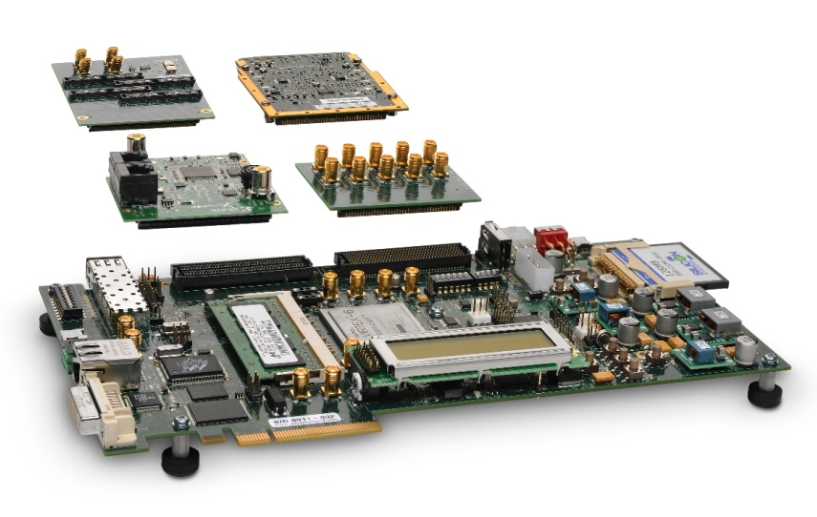
FPGA Mezzanine Card (FMC)
VITA Standard (VITA 57) for I/O mezzanine modules optimized to work with a FPGA-based carrier board
Deliver a stable, straightforward and compatible standard for board developers
Eliminates need for complex protocol logic on mezzanine
Maximizes data throughput
Minimizes latency
Reduces FPGA design complexity
Minimizes system overheads
Designed to work with industry-standard form-factors
PCI, PCI-X, VME, cPCI, ATCA, AMC …
www.vita.com/fmc
Notes:
2

Slide 3
The Problem
Connectors
FPGAs are very powerful and flexible
Large number of I/O pins
Very high performance, especially for operations that can be parallelized and for repetitive tasks
Many “hard” and “soft” IP cores available
Because of power and flexibility, FPGAs are often utilized in I/O portions of embedded systems
If I/O changes, the FPGA can be reprogrammed to handle new I/O, but a board respin is required to accommodate new I/O circuitry
No industry standard way to deal with FPGA I/O up to now
FPGA Board with I/O type A
I/O
circuitry A
FPGA
Connector
FPGA Board with I/O type B
I/O circuitry B
FPGA

Slide 4
The Solution
Take I/O off of the FPGA baseboard
Put it on a mezzanine card
Connectors
Connector
FPGA Board with I/O type A
FPGA Board with I/O type B
I/O
circuitry B
I/O
circuitry A
FPGA
FPGA

Slide 5
The Solution
Design FPGA board with mezzanine site
When I/O changes, only mezzanine card changes
Connectors
Connector
I/O
circuitry B
I/O
circuitry A
FPGA Board with I/O type A
FPGA Board with mezzanine site
FPGA Board with I/O type B
FPGA
FPGA
FPGA

Slide 6
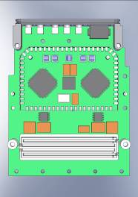
New I/O module standard: FMC – FPGA Mezzanine Card (VITA 57)
I/O mezzanine module optimized to work with a FPGA-based carrier board
Eliminates need for complex protocol logic on mezzanine
Maximizes data through-put
Minimizes latency
Reduces FPGA design complexity
Minimizes system overheads
Lower cost
Lower power
Better thermal characteristics than having the FPGA on a PMC/XMC mezzanine
Carrier with FPGA
FPGA

Slide 7
FMC – FPGA Mezzanine Card (VITA-57)
HPC
.
Single width module: 69x76.5mm (appr. ½ of PMC)
Double width variant also defined
Commercial and conduction cooled variants
Low pin count and high pin count connector
HPC: High Pin Count SeaRay Connector with 400 pins
LPC: Low Pin Count SeaRay Connector with 160 pins
Flexible interconnect between FMC and FPGA
Parallel I/O – single-ended or differential pairs
Up to 10 Multi-Gigabit Transceiver (MGT) high-speed serial links
.
160 single ended or 80 differential pairs
.
Power
JTAG
I²C
Clocks
.
.
.
10 MGT pairs
LPC
.
.
68 single ended or 34 differential pairs
.
Power
JTAG
I²C
Clocks
1 MGT pair

Slide 8
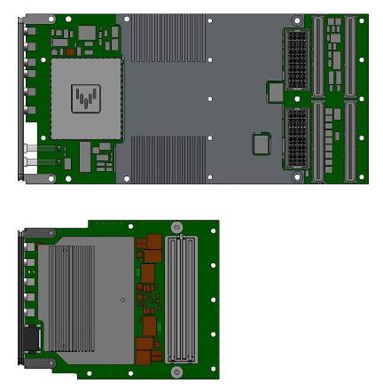
Comparison, XMC vs. FMC
XMC: 75x150 mm
FMC: 69x76.5 mm

Slide 9
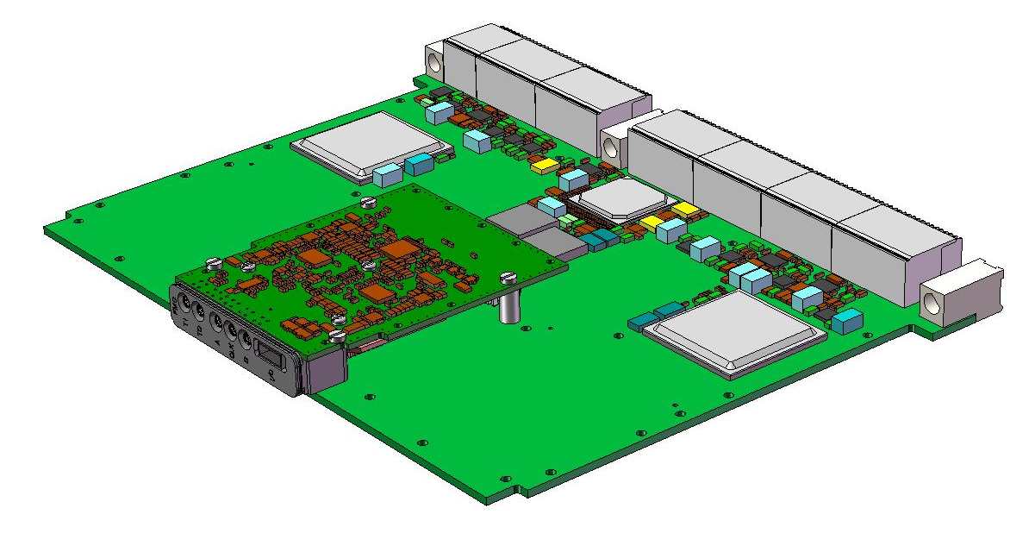
FMC on a 6U card
One…

Slide 10
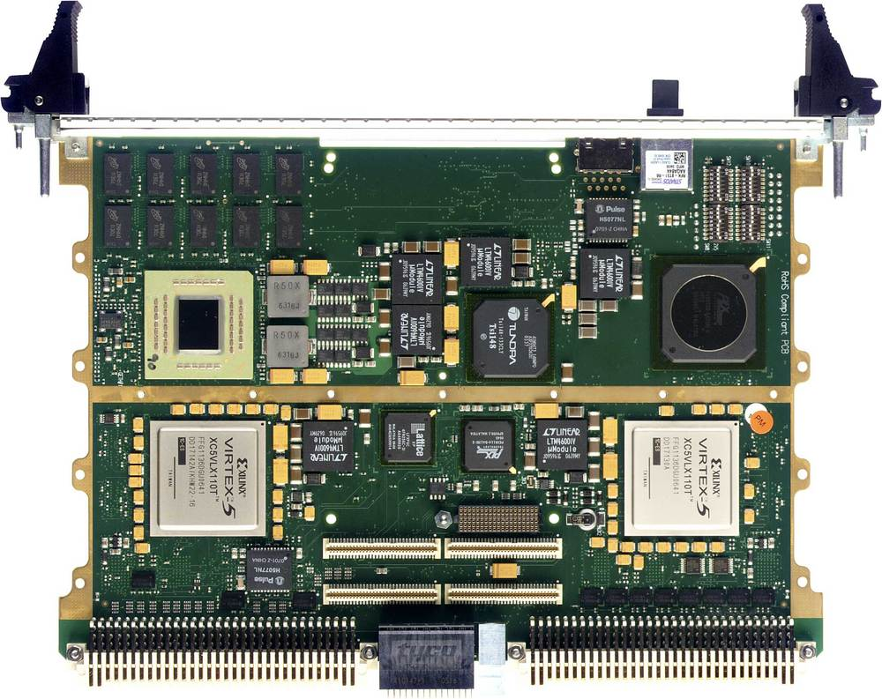
FMC Carrier Example with one FMC site

Slide 11
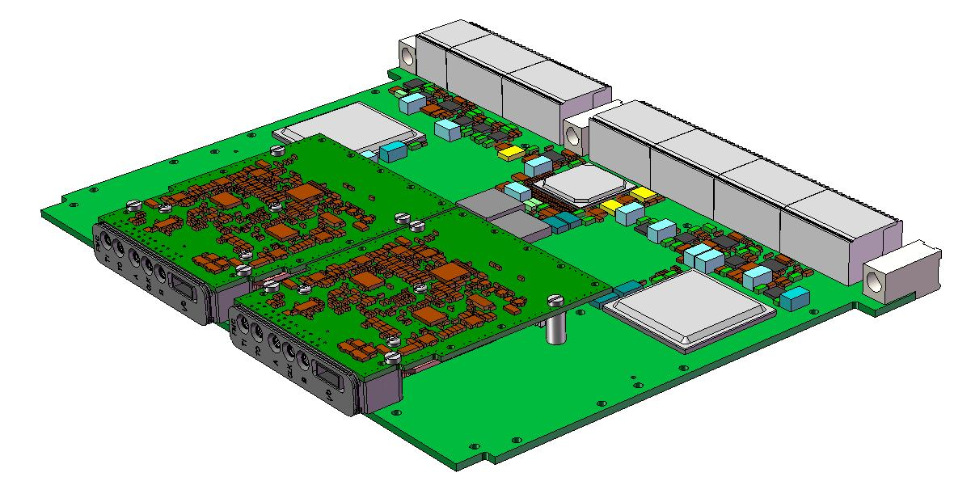
FMC on a 6U card
Two…

Slide 12
FMC Carrier Example with two FMC sites

Slide 13
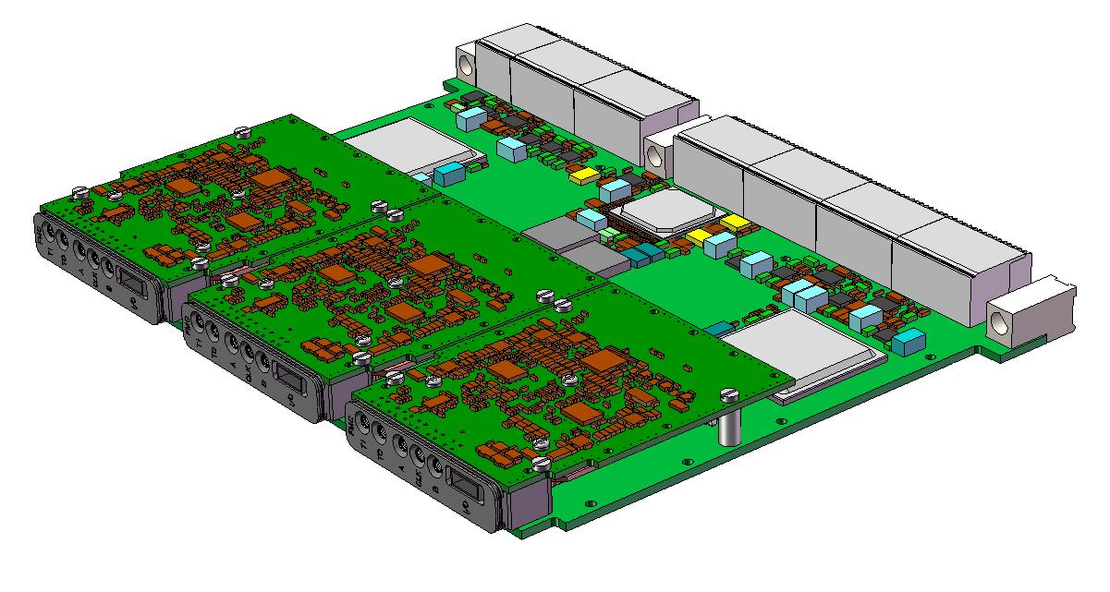
FMC on a 6U card
Three!

Slide 14
Functions suitable for FMC
Analog I/O: ADCs & DACs
Digital parallel I/O: e.g., Camera Link, LVDS, FPDP
Digital High-Speed Serial I/O: e.g., Fiber Optics, SerialFPDP, Gb/10Gb Ethernet
ADC
ADC
ADC
ADC
ADC
ADC
ANALOG I/O
PARALLEL I/O
HIGH SPEED
SERIAL
I/O

Slide 15
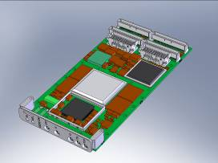
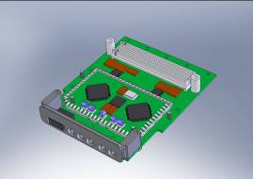
So now there are two I/O module formats
PMC / XMC
For high-speed Analog and Digital I/O and Fiber-Optics
Protocol engine (PCI-X, PCI Express, sRIO etc.)
For use with SBCs
Established standard – large ecosystem
FMC (VITA-57)
FPGA Mezzanine Card
Only I/O front end on module (FPGA sits on carrier)
HDL code provided to integrate into FPGA design
Emerging standard

Slide 16
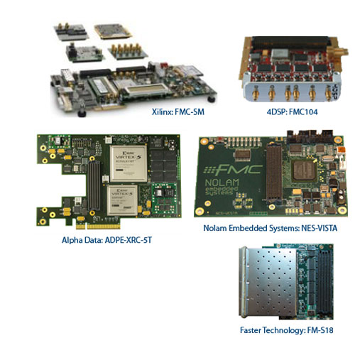
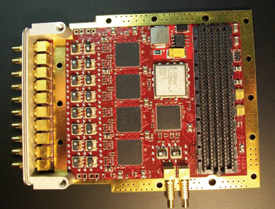
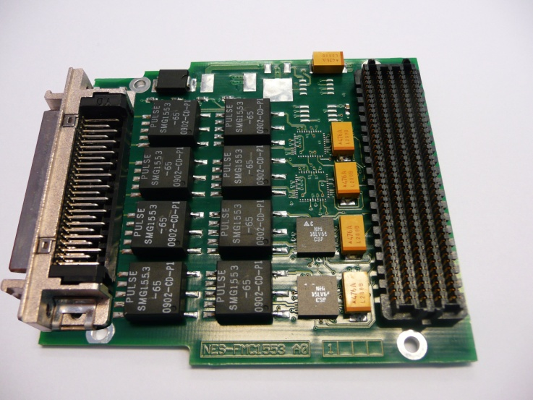
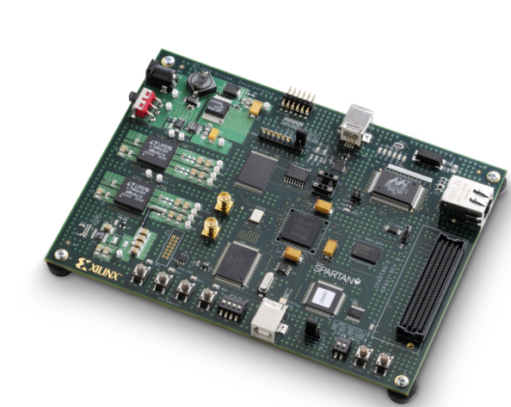
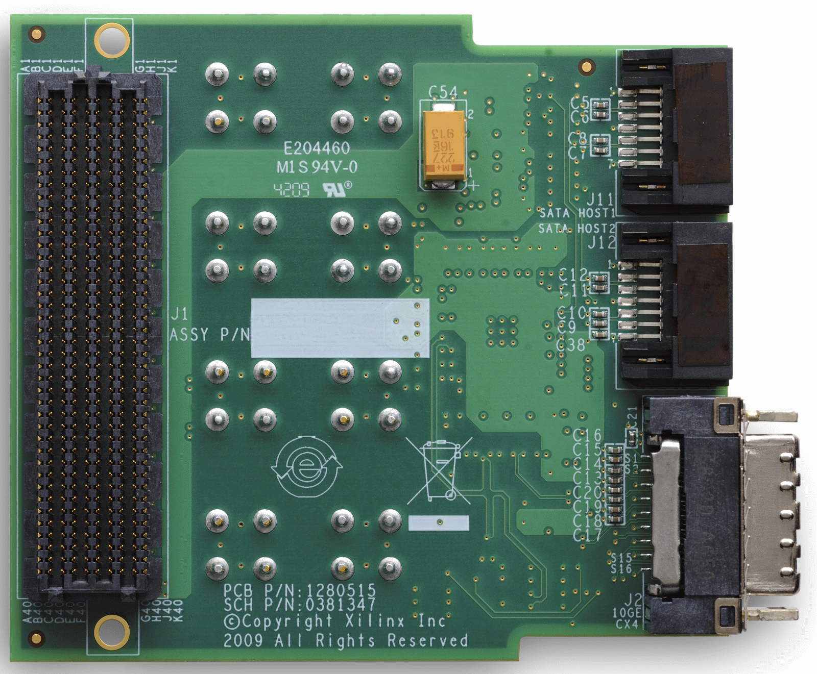
Sample Products

Slide 17
FMC Suppliers
 | FMC Modules |  |  |  |  |  |  | Carriers |  |  |  |  |  |  |  | Support
Company | High Speed Serial | Networking | Image Processing | A/D Converter | D/A Converter | Digital Receiver | RF Transceiver | AMC | VPX | VNX | VME | VXS | PCIe | CompactPCI | Motherboard | Connectors | Bezels | Dev. Platform
4DSP LLC |  |  |  | ✓ | ✓ |  |  |  | 3U |  |  |  |  | 3U
Avnet * |  |  | ✓ |  |  |  |  |  |  |  |  |  | ✓ |  |  |  |  | ✓
Alpha Data Parallel Systems Ltd |  |  |  |  |  |  |  |  |  |  |  |  | ✓
Annapolis Micro Systems |  |  |  |  |  |  |  | ✓
BittWare, Inc. |  |  |  | ✓ | ✓ |  |  | ✓ | 3U
Cook Tech * | ✓ |  | ✓
CES-Creative Electronic Systems |  |  |  |  |  |  |  |  |  | ✓
Curtiss-Wright |  |  |  | ✓ | ✓ |  |  |  | 3/6U
Faster Technology | ✓ | ✓
HiTech Global * | ✓ |  |  | ✓ | ✓
Intel Corporation |  |  |  |  |  |  |  |  |  |  |  |  |  |  |  |  |  | ✓
Interface Concept | ✓ | ✓ | ✓ | ✓ | ✓ |  |  |  | 3/6U |  | ✓
Kontron * |  |  |  |  |  |  |  |  | 3U |  | 6U
Lyrtech | ✓ | ✓ |  | ✓ | ✓ |  | ✓ | ✓ |  |  |  |  |  |  |  |  |  | ✓
Mercury Systems, Inc. |  |  |  |  |  | ✓ |  |  |  |  |  | 6U
MoSys
Nolam Embedded Systems * | ✓ |  |  | ✓ |  |  |  |  |  |  |  |  |  |  | ✓
Nutaq
Pentek, Inc. |  |  |  | ✓ | ✓
Parsec |  |  | ✓ | ✓ |  |  |  |  |  |  |  |  |  |  |  |  |  | ✓
Samtec, Inc. |  |  |  |  |  |  |  |  |  |  |  |  |  |  |  | ✓
TechwaY | ✓ | ✓ |  | ✓ |  |  |  |  |  |  |  |  | ✓ |  | ✓
Tokyo Electron Device Ltd. |  |  |  |  |  |  |  |  |  |  |  |  |  |  |  |  |  | ✓
VadaTech Inc. |  | ✓ |  | ✓ | ✓ |  | ✓ | ✓
Xilinx | ✓ |  | ✓ |  |  |  |  |  |  |  |  |  | ✓ |  |  |  |  | ✓
XTECH |  |  |  |  |  |  |  |  |  |  |  |  |  |  |  |  | ✓
* Not FMC Marketing Alliance member

Slide 18
For more information
VITA FMC Page
www.vita.com/fmc

