Slide 1
VITA 57.4 FMC+ Tutorial
Dylan Lang
Dylan.Lang@Samtec.com

Slide 2
Fmc+ abstract
Backwards compatibility and expanded user I/O: FMC+ extends FMC’s performance and modularity
Optical devices, serial memory, high-speed ADCs and DACs have necessitated additional Gigabit serial interfaces at speeds approaching 32 Gbps
Original FMC Standard approaching 10-year anniversary since its inception, modular form factor still widely used, however, data rate needs to increase
Modular approach to standard form factor allows for features such as AMC compatibility
Next generation FPGA mezzanine allows for compatibility with latest high performance serial devices

Slide 3
What is fmc+?
FMC+ is a Standard expanding the performance of FMC
Expanded performance achieved using optimized pin mapping within the FMC+ connector
Faster data rates, additional I/O, and backwards compatibility
FMC+ module designed for deployment in a wide variety of applications
Most common fields are FPGA development and VITA-based hardware systems like VPX
Standard defines both air cooled as well as ruggedized conduction cooled versions
Up to triple width modules are specified to facilitate applications requiring additional carrier card bandwidth, greater space on the front panel, or a larger PCB area.
New high-speed connector set provides high performance computing from the mezzanine I/O to the FPGA on the carrier card
FMC+ minimizes design time and creates a faster time-to-market

Slide 4
The story behind fmc+
Field Programmable Gate Array (FPGA) technology has proven to be invaluable to embedded designers for many years.
Aid in de-risking designs by allowing engineers to modify their logic after silicon is on the board. This allows for more efficient prototyping and a faster time to market.
Such diverse flexibility proved to limit demands of end users for a specific configuration.
This was especially true in the case of COTS developers.
A modular approach to a standardized form factor was driven through VITA.
This became FMC, was ratified July 2008.
Increased data rates and fundamentals of Moore’s Law demanded an interface that could handle improved performance.
FMC+ Technical Work Group founded in 2014.
Standard ratified and published by ANSI in July 2018.

Slide 5
Fmc+ signals
Parameter | FMC (VITA 57.1-2010) | FMC+/HSPC (VITA57.4) | FMC+/HSPCe (VITA57.4)
Number of DIFF/SE I/O | 80/160 | 80/160 | 80/160
M2C Clocks (DIFF) | 2 | 2 | 2
Bi-Dir clocks (DIFF) | 2 | 2 | 2
SYNC M2C+C2M (DIFF) | - | 1+1 | 1+1
REFCLK M2C+C2M (DIFF) | - | 1+1 | 1+1
Multi-gigabit transceivers (interfaces) | 10 | 24 | 32
Gigabit reference clocks | 2 | 6 | 8
Max transceiver data rate | 10Gbps | 28Gbps | 28Gbps
I2C EEPROM capacity | 2Kb (256x8) | 2Kb (256x8) 32Kb+ (4K+ x8) | 2Kb (256x8) 32Kb+ (4K+ x8)
Max Icc for 3P3VAUX power | 20mA | 100mA | 100mA
Max Single-width FMC module size (number of regions) | (5.2+71.3+7.5) x 66mm (3 regions) | (5.2+73.3+5.5) x 66mm (3 regions) or (5.2+73.3+5.5+10) x 66mm (4 regions) | (5.2+73.3+5.5+10) x 66mm (4 regions)
Max power | 10W | 10W | 10W
GA + JTAG + PowerGood + InstallID pins | 2+5+2+1 | 2+5+2+2 | 2+5+2+3
Reserved pins | 1 | 4 | 7
Connector pins (number of connectors) | 10x40 (1) | 14x40 (1) | 14x40 + 4x20 (2)

Slide 6
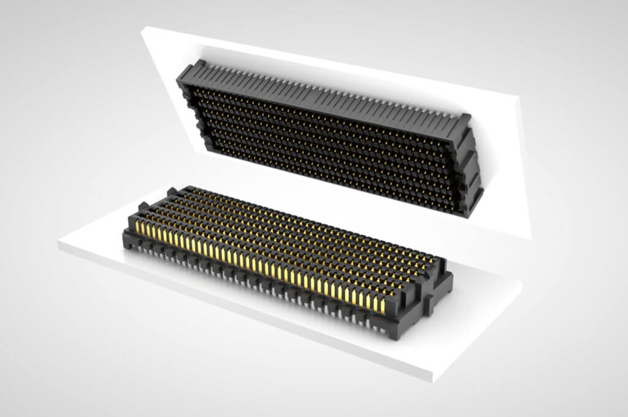
Fmc+ connector
FMC+ defines Samtec SeaRay HSPC (High Serial Pin Count) connector
14x40 configuration yielding 560 pins
Increases multi-gigabit interfaces from 10 to 24 MGTs
Multi-gigabit interface data rates up to 28Gbaud in each direction

Slide 7
Optional extension connector
FMC+ also specifies an optional HSPCe (High Serial Pin Count extension) connector
4x20 array yielding an additional 80 pins
Supports up to 8 additional multi-gigabit interfaces
Utilizing both HSPC and HSPCe enables support of 32 multi-gigabit interfaces with up to 896 Gbps over 32 channels

Slide 8
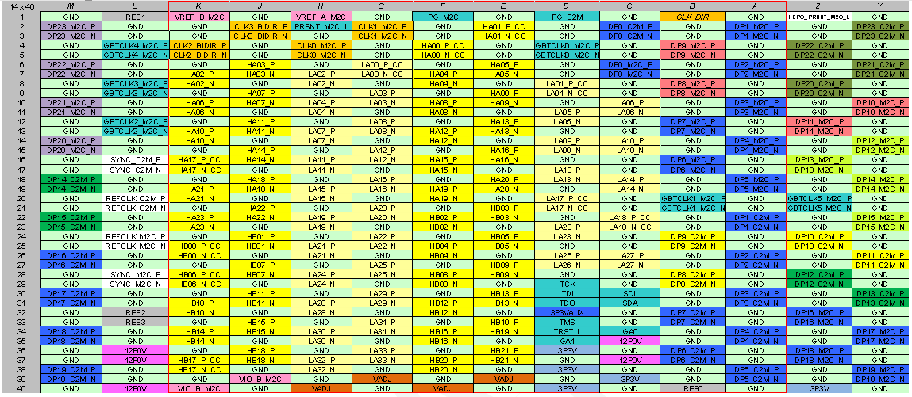
FMC+ HSPC pinout

Slide 9
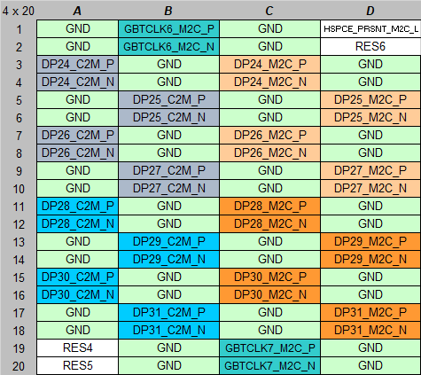
FMC+ HSPCe pinout

Slide 10
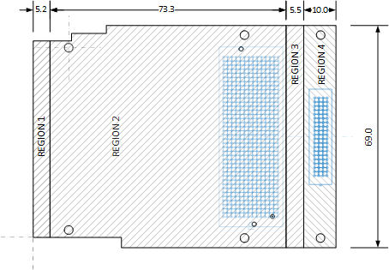
Fmc+ regions
HSPC Connector
HSPCe Connector
Regions 1 & 2 – Present on air-cooled carrier cards
Regions 2 & 3 - Present on ruggedized conduction cooled carrier cards
Regions 1-3 – Present on ruggedized conduction cooled carrier cards needing Region 1
Regions 1-4 – Present when the optional HSPCe connector area is needed
IO Area
31 mm x
50 mm
Conduction Cooled Thermal Interface

Slide 11
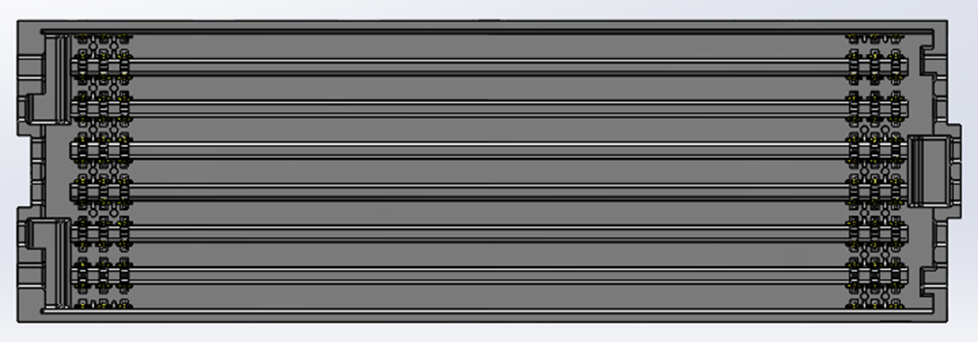
Backwards compatibility with fmc
Mechanically and electrically, FMC+ carriers are backwards compatible with FMC mezzanines
10x40 male FMC connector accepted by 14x40 female FMC+ connector
Allows for greater flexibility and support of legacy designs
Provides speeds of up to 10Gbps
10x40 FMC HPC Male
14x40 FMC+ HSPC Female

Slide 12
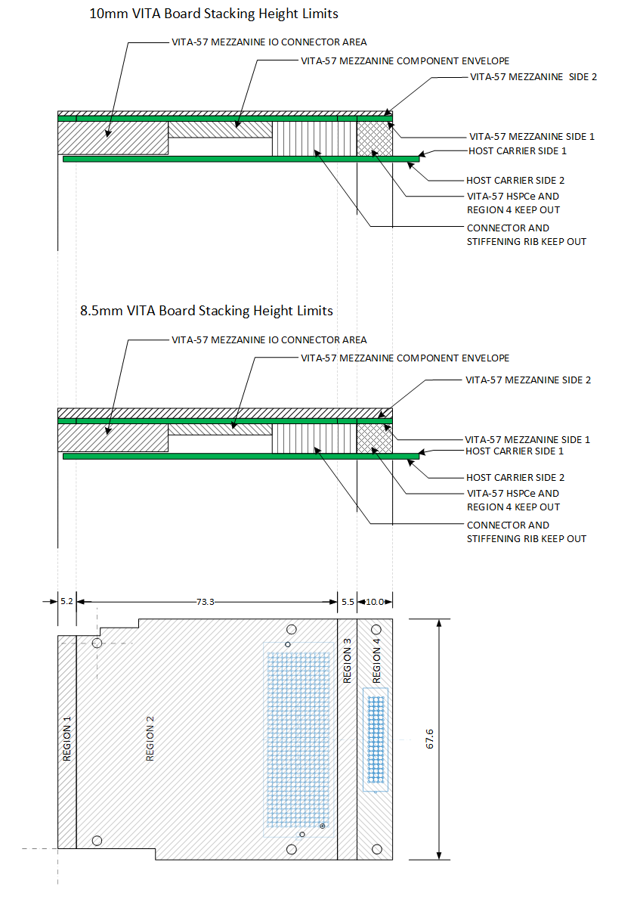
FMC+/AMC Carrier compatibility
FMC+ defines two stack heights, 8.5mm and 10mm, which can be applied to VITA and AMC applications
VITA applications allow for a minimum stack height of 8.5mm and a maximum of 10mm
To accommodate AMC applications, clearance areas at the front and rear ends of Side 2 of the mezzanine have been lowered

Slide 13
ecosystem
Expanding Ecosystem
FMC Community
FMC+ primarily adopted by two parties: FPGA Developers and VITA hardware
FMC+ technologies expanding beyond ADC/DAC
Optical, RF, and DSP configurations being released or in development
Gaining deeper interest in COTS market
New FMC+ Community being formed, to include discussions regarding marketing, technical advancements, and product development
Any parties interested in FMC/FMC+ should apply (vita.com/fmc)
Abaco Systems
Alpha Data Parallel Systems
Annapolis Micro Systems, Inc
ApisSys SAS
Atrenne Computing Solutions
BittWare, Inc.
Curtiss-Wright
Faster Technology
Intel Corporation
Interface Concept
Mercury Systems, Inc.
Nutaq
Pentek, Inc.
Parsec
ReFLEX CES
Samtec
Talent Technology Co., Ltd.
TechwaY
Tokyo Electron Device Ltd.
VadaTech Inc.
Xilinx

Slide 14
Working group history
Initial work started in 2015
ANSI Ratification in 2018
To update in 2023 per ANSI specification
New dot specifications underway
VITA 57.5 – Physical Tools to Aid in FMC+ Development
To include cable assemblies, loopback cards, and standoffs
VITA 57.1/57.4 Synergy
Currently, VITA 57.1 is undergoing its 5-year ANSI revision
Improved Figures and signal context to improve agreement between VITA 57.1 FMC/VITA 57.4 FMC+ specifications
Bundled as one Standard on vita.com

Slide 15
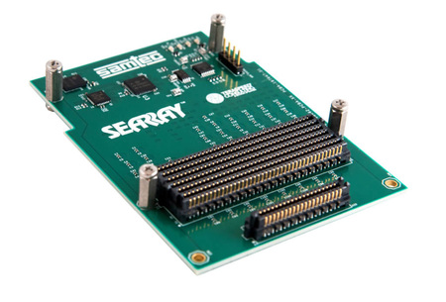
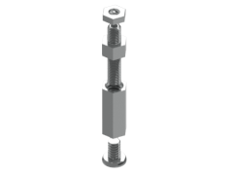
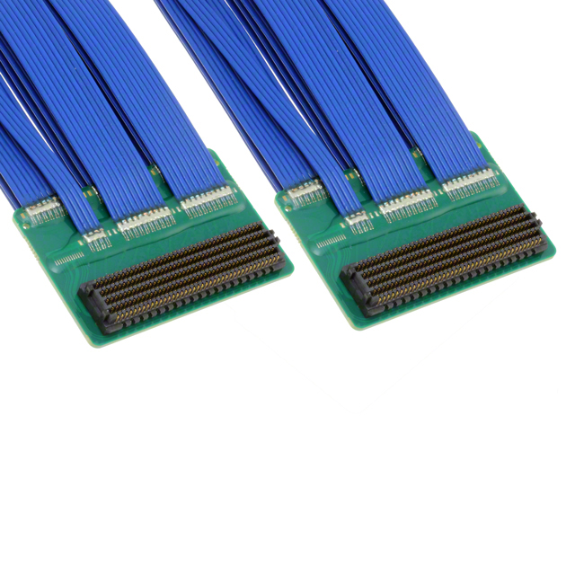
Vita 57.5 physical tools to aid in FMC+ development
Technical Work Group to begin late July/early August 2018
Tools to include:
Loopback Cards – development tool for FPGA designers looking to test and confirm signal integrity between mezzanines and carriers
Jumper Cables – appropriate for users looking to extend FMC+ signals over distances greater than the defined 8.5mm and 10mm stack heights
Jackscrew Standoffs – useful to ease separation of FMC configurations with high-pin counts (i.e. double and triple wide FMC+ cards utilizing HSPCe)

Slide 16
summary
FMC+ poised to see continued growth within FPGA and VITA communities
With additional I/O and higher data rates, FMC+ provides even greater flexibility for configurable FPGA I/O
New and existing adoptions of FMC+ include radio, optics, and advanced sensor/radar applications
With the addition of VITA 57.5 application notes, FMC family of standards will continue to prove advantageous:
Leading to a more rapid design process
Offering a cost-effective approach
Supporting more bandwidth and channels

Slide 17
Thank you

