Slide 1

Next Generation Space Interconnect Standard (NGSIS) SpaceVPX Tutorial
VITA 78 Working Group

Slide 2
First Things First
Updates to VITA 78

Slide 3
Updates as Part of the VITA 78 Revision
Reorganized protocol sections to include utility plane protocols and register structure
Added SpaceFibre as an alternate control and data plane on all modules
Enhanced Direct Access Protocol (DAP) for lightweight operation
Allows Control Plane to access DAP registers in addition to Utility Plane
Added redundant Geographical Address for fault tolerance
Restricted slot locations for certain module types
Reorganized SpaceUM sections making it follow document’s profile structure – Section 3.8, 3.9, and 3.10
Added smaller overhead 3U SpaceUM Modules that serve 5 logic slots
Added new power supply, power switch, and utility signal switch slots/modules

Slide 4
Updates as Part of the VITA 78 Revision
Lowered power on 3U modules to match SpaceVPXLite’ s 187.5mW/mm
Added additional module pitches for daughter cards and 3D constructs – 1.6” pitch
Added missing 3U mechanical drawings
Adjusted mechanical keep-out- areas
3U wedge-locks set to 250 and VITA 48.2 interoperable module handling described.
Added VITA 67.x and 66.x connector options to 3U and 6U Slot Profiles
Update to Floating Metal Section 4.5.2 to include exceptions to section Rules.
Added Ethernet (100BASE-KX, 10GBASE-KX4, 10GBASE-KR, and 1000BASE-T) to protocol section 5.7.

Slide 5
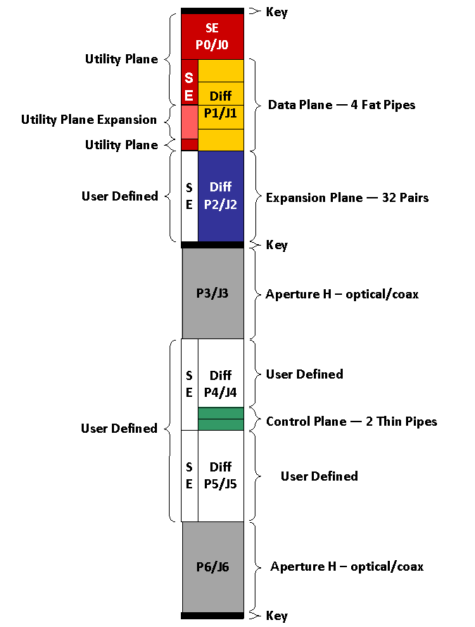
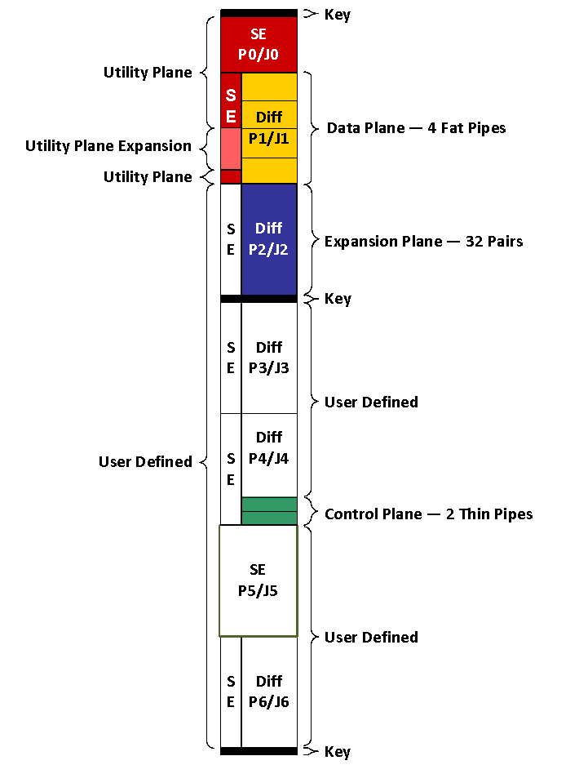
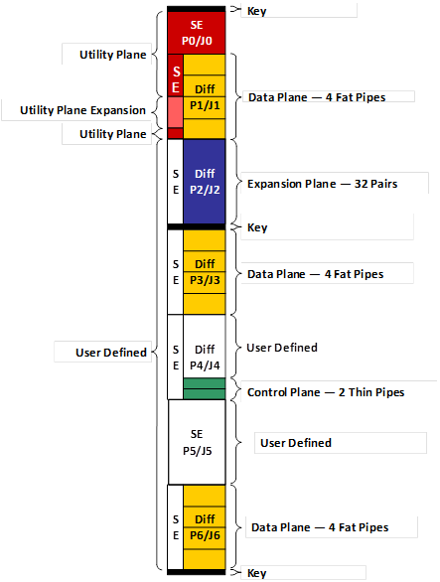
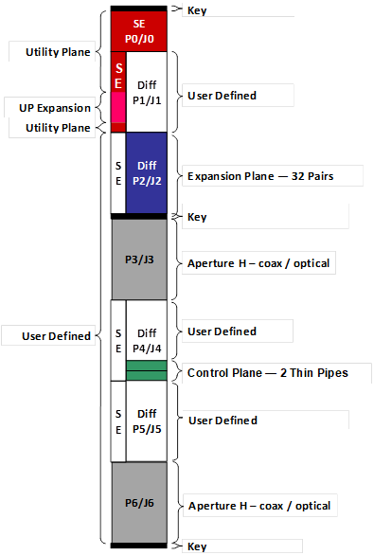
Updates to VITA 78 – 6U Slot Profiles
10.2.3/10.2.6(SE/cPCI)
10.2.4
10.2.5
10.3.2

Slide 6
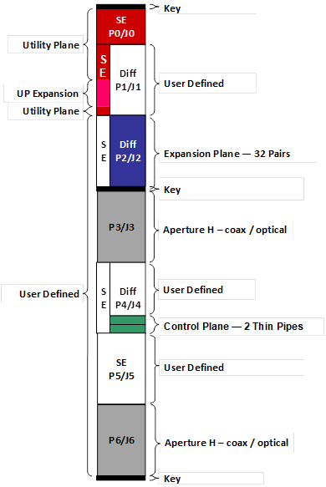
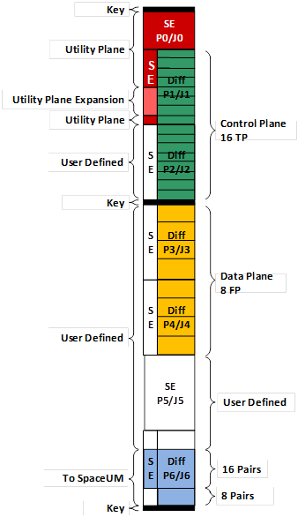
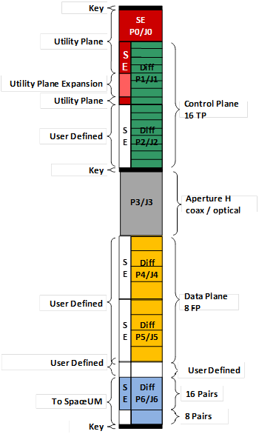
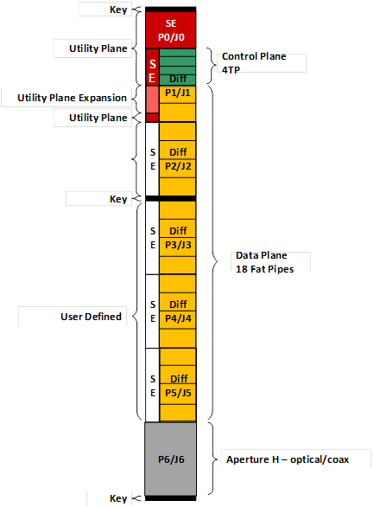
Updates to VITA 78 – 6U Slot Profiles
10.3.4
10.4.3
10.4.4
10.5.3

Slide 7
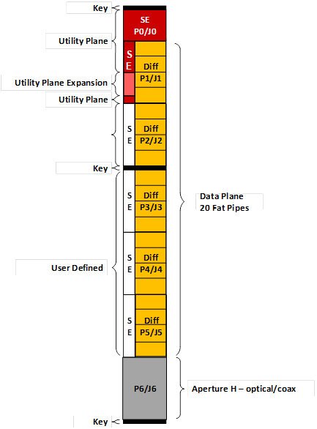
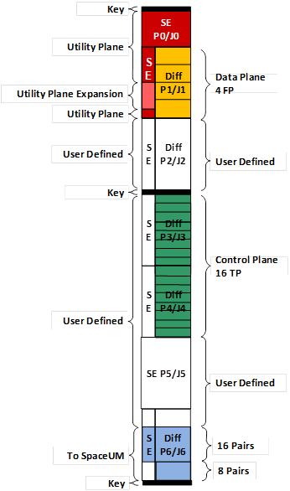
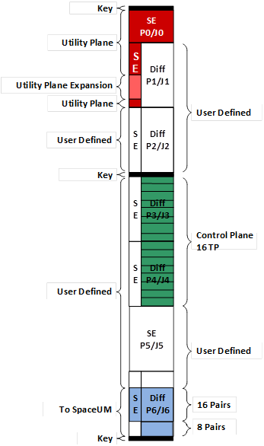
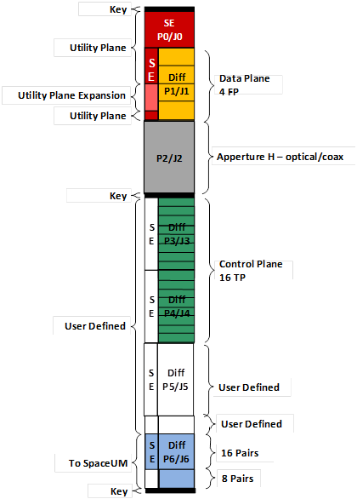
Updates to VITA 78 – 6U Slot Profiles
10.5.4
10.6.3
10.6.4
10.6.5

Slide 8
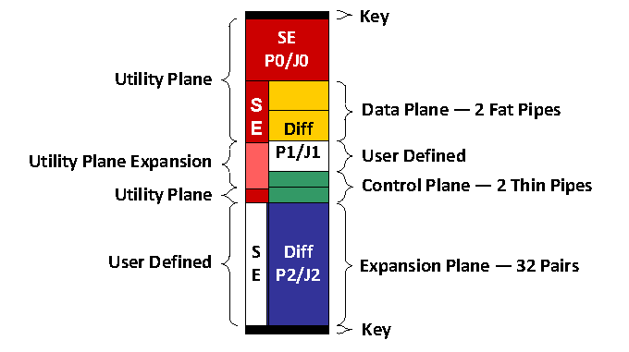
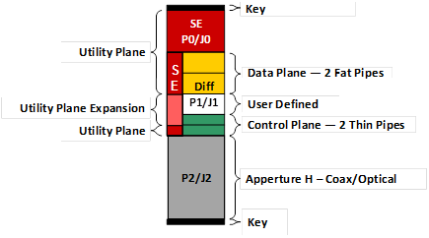
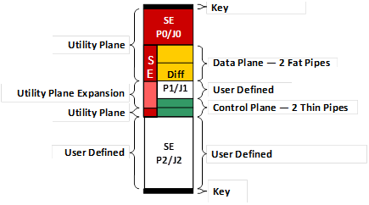
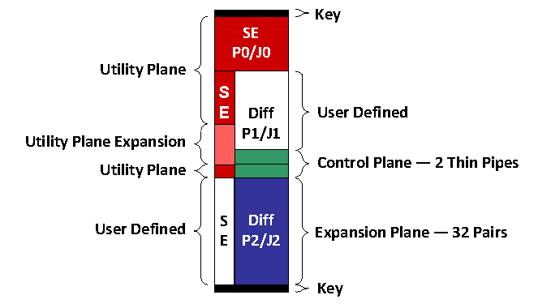
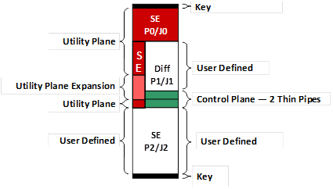
Updates to VITA 78 – 3U Slot Profiles
14.2.1 14.2.2 (Fiber/Coax) 14.2.3 (SE/cPCI)
14.3.2 Fiber/Coax)
14.3.1
14.3.3 SE/cPCI
14.2.4 14.2.5 (Fiber/Coax) 14.2.6 (SE/cPCI)

Slide 9
Updates to VITA 78 – 3U Slot Profiles
14.4.1 14.4.2 (½ Fiber/Coax) 14.4.3 14.4.4 (½ Fiber/Coax)
14.5.1 14.6.1 14.6.2 14.6.3

Slide 10
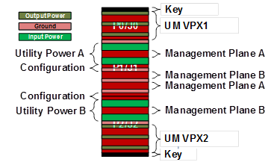
Updates to VITA 78 – 3U Slot Profiles
14.7.1 SpaceUM (2 slot) 14.7.2 SpaceUM (5 Slot)
14.8.1 PS Switch (6 Slot) 14.9.1 Utility Switch (10 Slot)

Slide 11
Bottom Line Up Front
What is wrong with the status quo?
Legacy space systems are often point solutions
Re-use is not a priority
Don’t have the full range of redundancy options (dual-string, M-of-N, etc.) built-in given the particular application and its needs.
Exposed interfaces are often proprietary and application specific
The interfaces are not key, well-defined, and open
Modules are not designed to inter-operate at either hardware or software level

Slide 12
Outline
What is SpaceVPX?
SpaceVPX Use Cases and Topologies
SpaceVPX Slot Profiles
SpaceVPX Backplane Profile
SpaceUM - Provisions for Redundancy and Fault Tolerance
SpaceVPX Mechanical General Specifications
SpaceVPX Compliance
Backup

Slide 13
What is NGSIS? (Original)
SpaceVPX
SpaceVPXLite
RapidIO Space Device Class
The Next Generation Space Interconnect Standard

Slide 14
Constituent Parts
RIO Space Device Class
SpaceVPXLIte
SpaceVPX
SpaceVNX
High Reliability Systems
SpaceFibre
SpaceWire

Slide 15
Targets or Marketplace
Large Systems
Small Systems
Medium Systems
Cube Sat
High Reliability Systems – Non-Space
Targets are typically Large, Medium, and Small High Performance Computing Systems that are Sensor Driven
New Market Focus on Cube Sats and Non-Space High Reliability Systems
SpaceVPX
SpaceVPX/
SpaceVNX
SpaceVNX
SpaceVPX

Slide 16





















SpaceVPX Participants and Products

Slide 17
Goals for SpaceVPX - Overarching
Develop
Enhanced set of Slot Profile interface and Backplane interface specifications that are based upon existing commercial standards with added features required for space applications.
Increase
Interoperability and compatibility between manufacturers and integrators, while simultaneously increasing affordability through the use of hardware with key, well-defined, and open interfaces.
Scale
  Performance and Capability based upon user’s needs and requirements

Slide 18
What are SpaceVPX’s Goals?
Created to bridge the VPX standards to the space market.
SpaceVPX addresses both interoperability (as OpenVPX does) and space application needs (not in OpenVPX).
SpaceVPX defines Payload, Switch, Controller, and Backplane module profiles to meet needs of space applications
SpaceVPX adds features to the Utility Plane for fault tolerance
    Point-to-point not bussed to tolerate faults: failure on module does not affect entire system.
    Space Utility Module added to provide dual-redundant source for Utility Plane implementations.
SpaceVPX defines use of SpaceWire and Ethernet (new) for Control Plane

Slide 19



What is in SpaceVPX?
VITA 65.0
VITA 46.0
VITA 46.3
SRIO on VPX
VITA 46.9
PMC/XMC
VITA 46.11
Sys. Management
VITA 48.2 Conduction
SpaceVPX
SpaceFibre/SpaceWire
SpaceVPXLite
PCIe
Ethernet
Direct Access Protocol

Slide 20
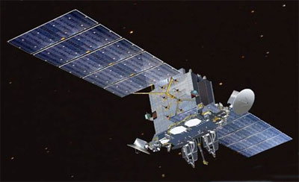


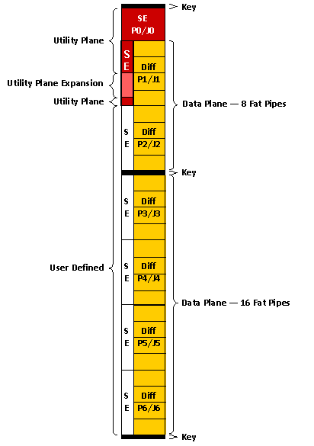
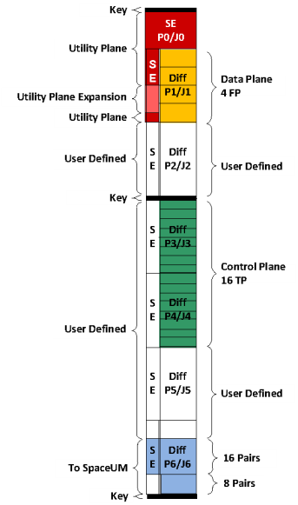
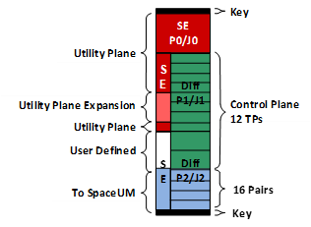
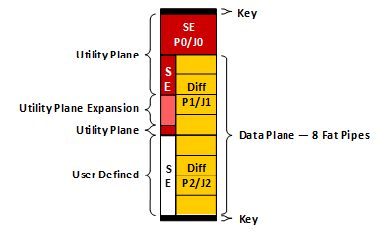
Modular Building Blocks
Payload input
Payload input
Payload input
Processing card
Processing card
Switch card
Memory card
Output card
Power card
Payload input
Payload input
Payload input
Processing card
Processing card
Switch card
Memory card
Output card
Power card
Payload input
Payload input
Payload input
Processing card
Processing card
Switch card
Memory card
Output card
Power card
Satellite Platform

Slide 21
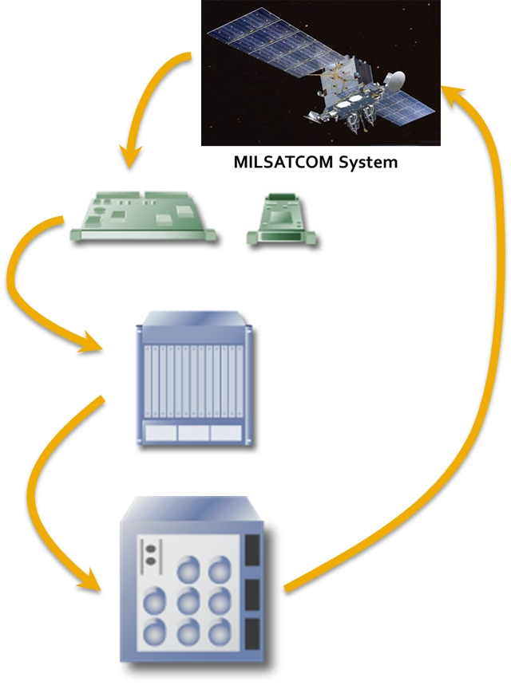
Simplified SpaceVPX Development Flow
Determine application requirements
  Size, weight and power
  Processing, fabric and I/O requirements
Select overall system parameters
  3U or 6U?
  Switching topology?
  Number and type of slots?
Assemble development vehicle
  COTS development chassis
  COTS boards
  COTS or custom RTMs
Design deployment system
  Typically custom backplane
  Typically route I/O signals to custom
  I/O slot or bulkhead connector

Slide 22
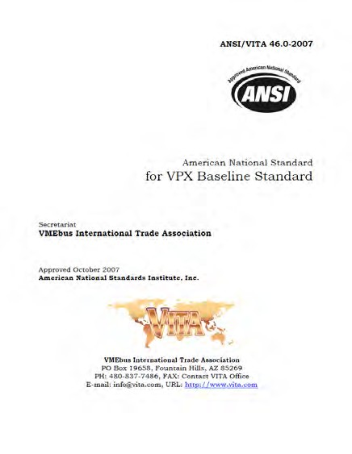
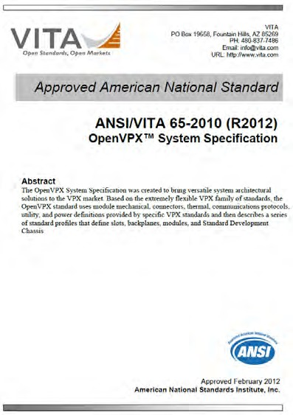
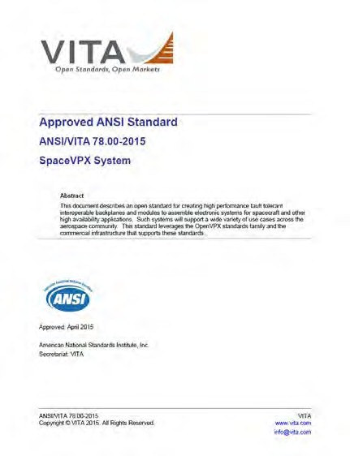
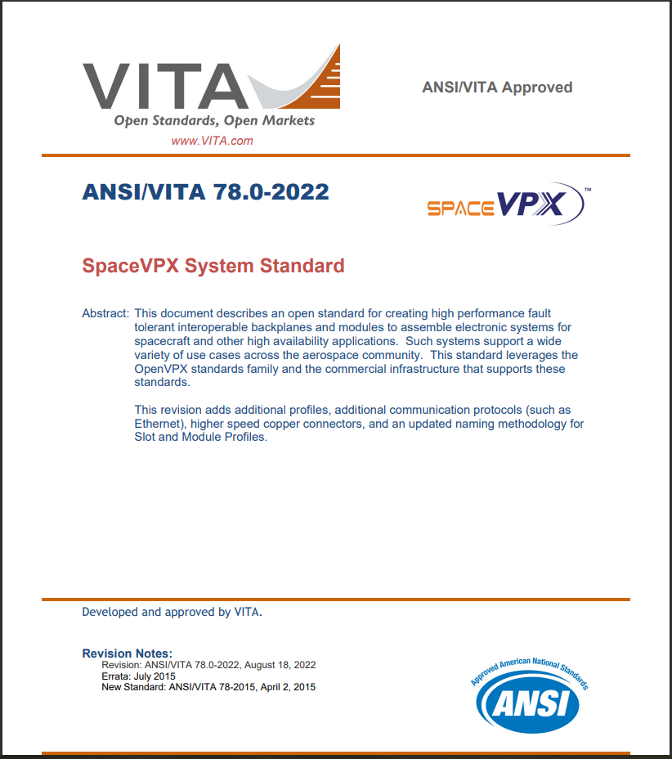
SpaceVPX adapts OpenVPX MOSA for Space
SpaceVPX allows flexibility in radial utility distribution and control
The Space Utility Module (SpaceUM) distributes and switches the OpenVPX reset, clocks and power to remove the vulnerability to single point failures.
VPX OpenVPX SpaceVPX – 2015 SpaceVPX – 2022
VPX has progressed from Avionics to Space Modular Open Systems

Slide 23
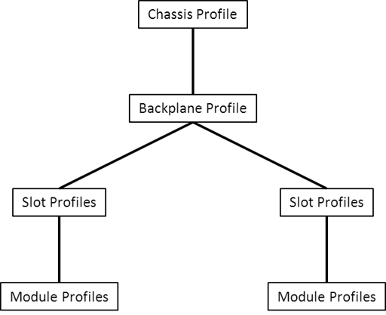
SpaceVPX Document Structure Description

Slide 24
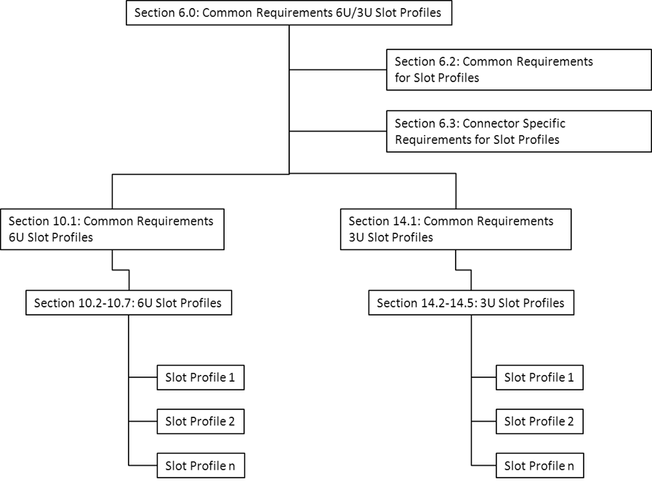
SpaceVPX Document Structure Description

Slide 25
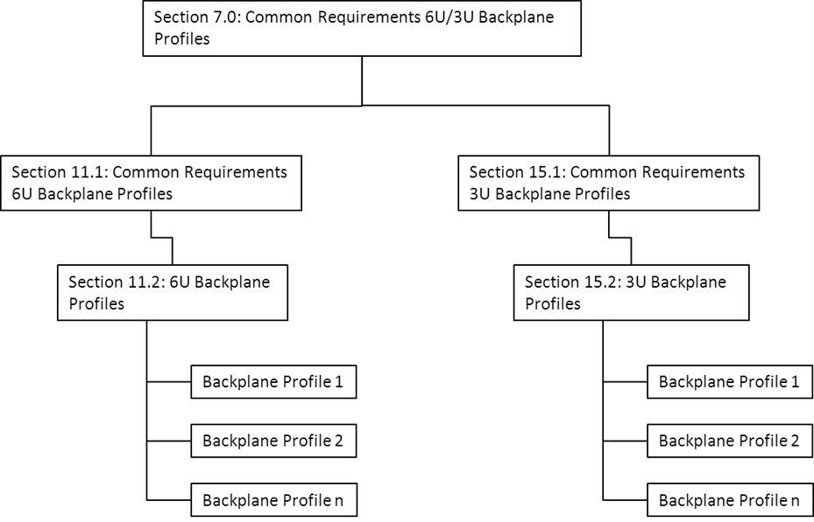
SpaceVPX Document Structure Description

Slide 26
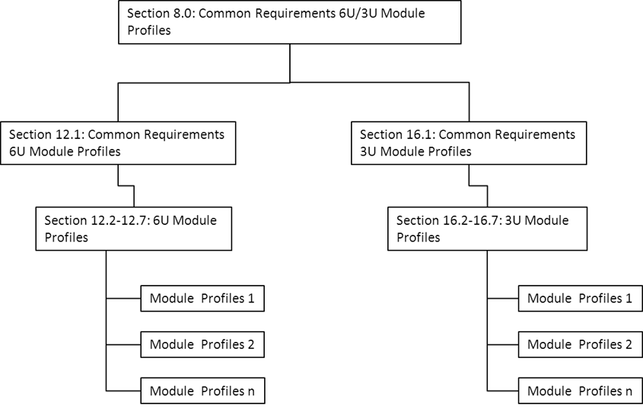
SpaceVPX Document Structure Description

Slide 27
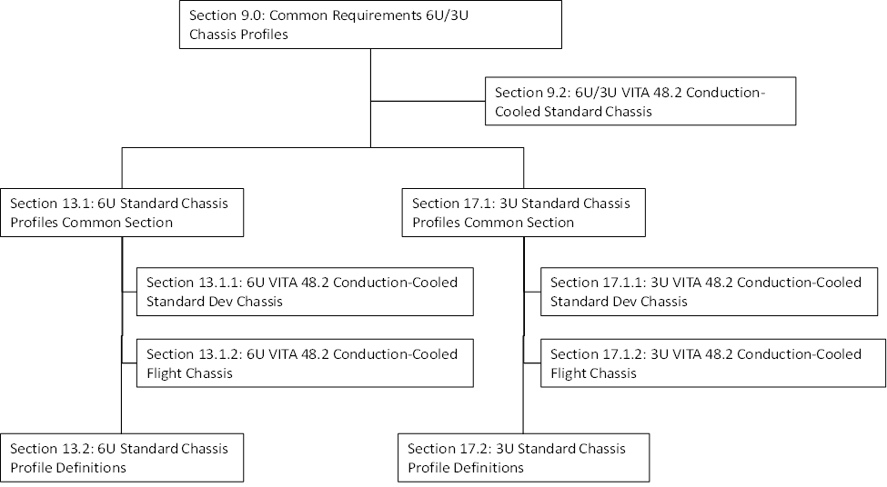
SpaceVPX Document Structure Description

Slide 28
Outline
What is SpaceVPX?
SpaceVPX Base Use Case and Topologies
SpaceVPX Slot Profiles
SpaceVPX Backplane Profile
SpaceUM - Provisions for Redundancy and Fault Tolerance
SpaceVPX Mechanical General Specifications
SpaceVPX Compliance
Backup

Slide 29
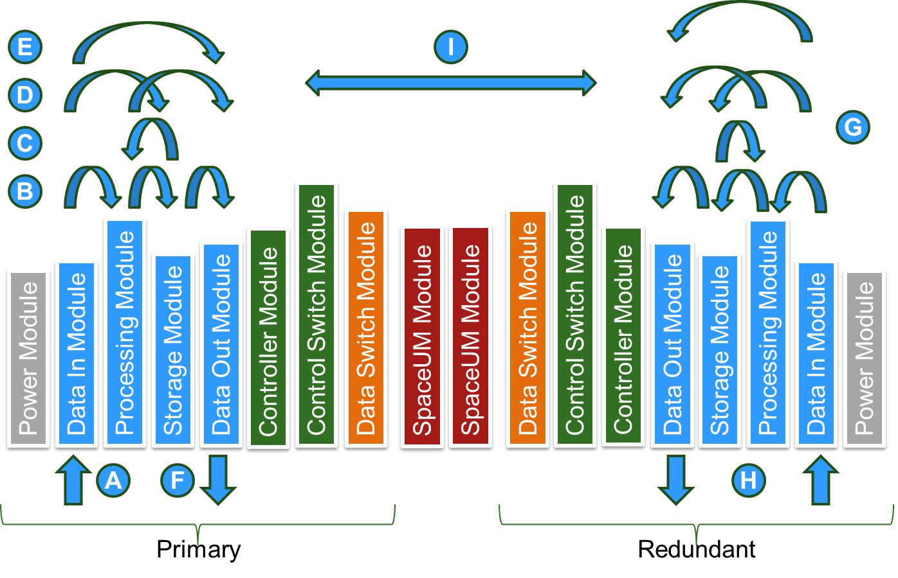
Basic SpaceVPX Payload Use Case

Slide 30
Backplane Physical Topologies
SpaceVPX backplane profiles include Data Plane configurations using both Star and Mesh topologies. (Other Data Plane topologies are possible.)
A Star topology
Connects Payload Slots through centralized Switch Slots. The SpaceVPX Control Plane always uses the Star topology while the SpaceVPX Data Plane can be either a Star topology or a Mesh topology.
Note - That when the Control and Data planes are both Star topology, the Control and Data plane switches can be combined on a single module.
Note - In Star topologies with dual redundant fault tolerance, each switch topology has two switch slots, and all Payload slots are connected to each switch slot.
A Mesh topology
Connects each of the Payload Slots directly to other Payload slots, without the use of a centralized Switch Slot.

Slide 31
Backplane Physical Topologies
SpaceVPX backplane profiles include Data Plane configurations using both Star and Mesh topologies. Other Data Plane topologies are possible.
The SpaceVPX Data Plane
Is implemented as a full mesh where each Payload Slot data plane interface is connected to each of the other Payload Slots.
In a full-mesh,
Failure of one module does not adversely affect the ability of any working module to communicate with any other working module in the mesh.
Also, modules in the mesh can be in a standby redundant off-state without adversely affecting communication between modules turned on.
Note - Any mesh configuration requiring one or more modules to be alive and working for other modules in the mesh to communicate with other are not conducive to space applications.

Slide 32
Physical Topologies
Dual-Star Topology
Dual-Star Topology with PCI Expansion
Full Mesh Topology

Slide 33
Outline
What is SpaceVPX?
SpaceVPX Use Cases and Topologies
SpaceVPX Slot Profiles
SpaceVPX Backplane Profile
SpaceUM - Provisions for Redundancy and Fault Tolerance
SpaceVPX Mechanical General Specifications
SpaceVPX Compliance
Backup

Slide 34
Slot Profiles
Power related signals are reds and oranges
Signals are greens, yellows and blues
Unused pins are grey
Miscellaneous utility signals are purple
Signals | Color (Microsoft Definition) | Example
Power Feeds | Red | PF
VS1, VS2, VS3 | rose | VS1
VBAT, auxilary power, sense lines | light orange | VBAT
UD (abbreviated UD) | tan | UD
Control plane | light green | CPtp02
Data plane | pale blue | DP01
Expansion plane | light turquoise | EP02
PCI signals | aqua | PCI
control/data/Expansion plane, contrast | light yellow | DP02
Grounds | none | GND
Reserved Pins (abbreviated RSVD) | grey 25% | RSVD
No pad | grey 50% | No Pad*
Global Address, System Controller | light blue | GA
Reference Clock, Auxiliary Clock | yellow | REF_CLK
System Management, JTAG | sea green | SM
SYSRESET, NVMRO, Maskable Reset | lavender | SYSRESET*
Power select | dark red | Power SEL

Slide 35
What is in SpaceVPX (Profiles)
Slot Profile
A physical mapping of ports onto a slot’s backplane connectors
Extends a slot profile by mapping protocols to a module’s ports
Module Profile
Backplane Profile
Profile Name | Data Plane 4 FP | Expansion Plane P2/J2 | Control Plane 2 TP | User Defined
 | DP01 to DP04 |  | CPtp01 to CPtp02 | P3/J3, P5/J5
MOD6-PAY-4F1Q2T-12.2.1-6-cc.pp | sRIO 2.2 per Section 5.3 | User Defined – DIFF Pins | SpaceFibre per Section 5.5 | DIFF pins
MOD6-PAY-4F1Q2T-12.2.1-7-cc.pp | SpaceFibre per Section 5.5 | SpaceFibre per Section 5.5 | SpaceFibre per Section 5.3.1 | DIFF pins
MOD6-PAY-4F1Q2T-12.2.1.9-cc.pp | Ethernet per Section 5.7 | Ethernet per Section 5.7 | SpaceWire per Section 5.4 | DIFF pins
MOD6-PAY-4F1Q2T-12.2.1.10-cc.pp | Ethernet per Section 5.7 | User Defined – DIFF Pins | SpaceWire per Section 5.4 | DIFF pins
A physical specification of a backplane
Also: Power Keying and Chassis profiles

Slide 36
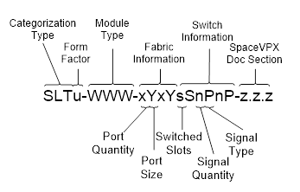
Module Profiles
Profile Name | Data Plane 4 FP | Expansion Plane P2/J2 | Control Plane 2 TP | User Defined
 | DP01 to DP04 |  | CPtp01 to CPtp02 | P3/J3, P5/J5
MOD6-PAY-4F1Q2T- 1 2.2.1-1-cc | sRIO 2.2 at 3.125 Gbaud per Section 5.2 | sRIO 2.1 at 3.125 Gbaud per Section 5.2 | SpaceWire per Section 5.2.1 | User Defined DIFF pins
Module Profiles specify a particular Slot Profile and the protocols that go on groups of pins
  The section number and sequence number at the end of the name make sure it is unique
  Module Profile sections, in ANSI/VITA 65.0/65.1, use the sequence number, to specify a particular combination of protocols out of the multiple options

Slide 37
Module Profile Protocols in SpaceVPX (VITA 78) Currently
Intelligent Platform Management Interface (IPMI) Protocol
Direct Access Protocol (DAP)
Serial RapidIO (SRIO)
SpaceWire (SpW)
SpaceFibre (SpF)
PCI
Ethernet

Slide 38
Rates Supported in SpaceVPX (VITA 78)
SRIO
1.0, 2.0, 2.5, 4, and 5 Gbps per lane
Ethernet
1000BASE-KX
10GBASE-KX4
10GBASE-KR
1000BASE-T
PCI for us with cPCI
The use of PCI with SpaceVPX is generally intended for bridging applications to provide connectivity with the SpaceVPX network planes (Control Plane or Data Plane).
Because SpaceVPX only specifies the connector pin assignments for using PCI, other applications can use the PCI support to implement hybrid SpaceVPX and CompactPCI backplanes (with or without bridging).

Slide 39
Example Set of 6U Module Profiles
Profile Name | Data Plane 4 FP | Expansion Plane P2/J2 | Control Plane 2 TP | User Defined
 | DP01 to DP04 |  | CPtp01 to CPtp02 | P3/J3, P5/J5
MOD6-PAY-4F1Q2T-12.2.1-1-cc.pp | sRIO 2.2 per Section 5.3 | sRIO 2.2 per Section 5.3 | SpaceWire per Section 5.4 | DIFF pins
MOD6-PAY-4F1Q2T-12.2.1-2-cc.pp | sRIO 2.2 per Section 5.3 | User Defined – DIFF Pins | SpaceWire per Section 5.4 | DIFF pins
MOD6-PAY-4F1Q2T-12.2.1-3-cc.pp | SpaceFibre per Section 5.5 | SpaceFibre per Section 5.5 | SpaceWire per Section 5.4 | DIFF pins
MOD6-PAY-4F1Q2T-12.2.1-4-cc.pp | SpaceFibre per Section 5.5 | User Defined – DIFF Pins | SpaceWire per Section 5.4 | DIFF pins
MOD6-PAY-4F1Q2T-12.2.1-5-cc.pp | sRIO 2.2 per Section 5.3 | sRIO 2.2 per Section 5.3 | SpaceFibre per Section 5.5 | DIFF pins
MOD6-PAY-4F1Q2T-12.2.1-6-cc.pp | sRIO 2.2 per Section 5.3 | User Defined – DIFF Pins | SpaceFibre per Section 5.5 | DIFF pins
MOD6-PAY-4F1Q2T-12.2.1-7-cc.pp | SpaceFibre per Section 5.5 | SpaceFibre per Section 5.5 | SpaceFibre per Section 5.3.1 | DIFF pins
MOD6-PAY-4F1Q2T-12.2.1.9-cc.pp | Ethernet per Section 5.7 | Ethernet per Section 5.7 | SpaceWire per Section 5.4 | DIFF pins
MOD6-PAY-4F1Q2T-12.2.1.10-cc.pp | Ethernet per Section 5.7 | User Defined – DIFF Pins | SpaceWire per Section 5.4 | DIFF pins
MOD6-PAY-4F1Q2T-12.2.1.11-cc.pp | Ethernet per Section 5.7 | Ethernet per Section 5.7 | SpaceFibre per Section 5.5 | DIFF pins
MOD6-PAY-4F1Q2T-12.2.1.12-cc.pp | Ethernet per Section 5.7 | User Defined – DIFF Pins | SpaceFibre per Section 5.5 | DIFF pins
MOD6-PAY-4F1Q2T-12.2.1.13-cc.pp | Ethernet per Section 5.7 | Ethernet per Section 5.7 | Ethernet per Section 5.7 | DIFF pins
MOD6-PAY-4F1Q2T-12.2.1.14-cc.pp | Ethernet per Section 5.7 | User Defined – DIFF Pins | Ethernet per Section 5.7 | DIFF pins

Slide 40
Mapping between VITA 78-2022 and VITA 78-2015
VITA 78-2021 Module Profile Version | VITA 78-2015 Module Profile Version
MOD6-PAY-4F1Q2T-12.2.1-1-cc.pp | MOD6-PAY-4F1Q2T-12.2.1-1-cc MOD6-PAY-4F1Q2T-12.2.1-2-cc MOD6-PAY-4F1Q2T-12.2.1-3-cc
MOD6-PAY-4F1Q2T-12.2.1-2-cc.pp | MOD6-PAY-4F1Q2T-12.2.1-4-cc MOD6-PAY-4F1Q2T-12.2.1-5-cc MOD6-PAY-4F1Q2T-12.2.1-6-cc MOD6-PAY-4F1Q2T-12.2.1-7-cc MOD6-PAY-4F1Q2T-12.2.1-8-cc MOD6-PAY-4F1Q2T-12.2.1-9-cc

Slide 41
Example Set of 3U Module Profiles
Profile Name | Data Plane 2 FP | Control Plane 2 TP | Expansion Plane
 | DP01 to DP02 | CPtp01 to CPtp02 | P2/J2
MOD3-PAY-2F2T1Q-16.2.1-1-cc.pp | sRIO 2.2 per Section 5.3 | SpaceWire per Section 5.4 | sRIO 2.2 per Section 5.3
MOD3-PAY-2F2T1Q-16.2.1-2-cc.pp | SpaceFibre per Section 5.5 | SpaceWire per Section 5.4 | SpaceFibre per Section 5.5
MOD3-PAY-2F2T1Q-16.2.1-3-cc.pp | sRIO 2.2 per Section 5.3 | SpaceFibre per Section 5.5 | sRIO 2.2 per Section 5.3
MOD3-PAY-2F2T1Q-16.2.1-4-cc.pp | SpaceFibre per Section 5.5 | SpaceFibre per Section 5.5 | SpaceFibre per Section 5.5
MOD3-PAY-2F2T1Q-16.2.1-5-cc.pp | sRIO 2.2 per Section 5.3 | SpaceWire per Section 5.4 | User Defined DIFF Pins
MOD3-PAY-2F2T1Q-16.2.1-6-cc.pp | SpaceFibre per Section 5.5 | SpaceWire per Section 5.4 | User Defined DIFF Pins
MOD3-PAY-2F2T1Q-16.2.1-7-cc.pp | sRIO 2.2 per Section 5.3 | SpaceFibre per Section 5.5 | User Defined DIFF Pins
MOD3-PAY-2F2T1Q-16.2.1-8-cc.pp | SpaceFibre per Section 5.5 | SpaceFibre per Section 5.5 | User Defined DIFF Pins
MOD3-PAY-2F2T1Q-16.2.1-9-cc.pp | Ethernet per Section 5.7 | SpaceWire per Section 5.4 | Ethernet per Section 5.7
MOD3-PAY-2F2T1Q-16.2.1-10-cc.pp | Ethernet per Section 5.7 | SpaceFibre per Section 5.5 | Ethernet per Section 5.7
MOD3-PAY-2F2T1Q-16.2.1-11-cc.pp | Ethernet per Section 5.7 | Ethernet per Section 5.7 | Ethernet per Section 5.7
MOD3-PAY-2F2T1Q-16.2.1-12-cc.pp | Ethernet per Section 5.7 | SpaceWire per Section 5.4 | User Defined DIFF Pins
MOD3-PAY-2F2T1Q-16.2.1-13-cc.pp | Ethernet per Section 5.7 | SpaceFibre per Section 5.5 | User Defined DIFF Pins
MOD3-PAY-2F2T1Q-16.2.1-14-cc.pp | Ethernet per Section 5.7 | Ethernet per Section 5.7 | User Defined DIFF Pins

Slide 42
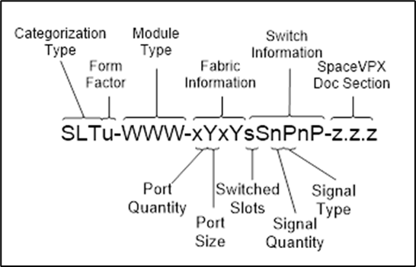
Slot Profiles – Example
Slot Profiles Define Pin Assignments for Both Plug-In Modules and Backplanes, independent of protocol
  With 6U P0 thru P6 are Plug-In Module connectors
  J0 thru J6 are backplane connectors
With most SpaceVPX Profiles P1/J1 thru P6/J6 are mostly differential pairs
  32 differential pairs / connector – 16 lanes
  8 single-ended pins / connector
  6 connectors give a total of 192 pairs and 48 single-ended
SpaceVPX 6U Slot Profile:
SLT6-PAY-4F1Q2T-10.2.1
Single-Ended pins
Differential pins

Slide 43
Mapping Interfaces to SpaceVPX Slot Profiles
Utility plane provides power, configuration, timing and management input signals using I2C, CMOS and LVDS levels
Ethernet, SRIO, or SpaceFibre is used for the data plane
x1 interface = 1 Ultra thin pipe (UTP)
x2 interface = 1 Thin Pipe (TP)
x4 interface = 1 Fat Pipe (FP)
Expansion Plane for additional Data FPs, Heritage I/Fs or
User Defined Signals
SpaceWire or Ethernet is used for the control plane
1 interface = 1 Thin Pipe (TP)
User Defined Space
Signals to and from the SpaceUM

Slide 44
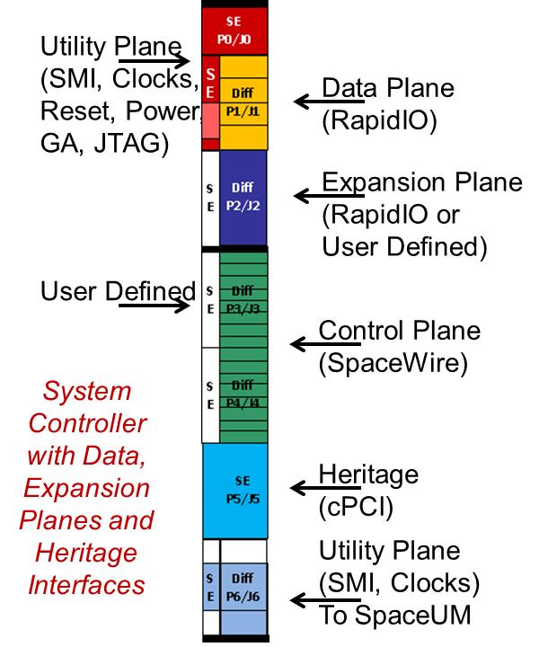
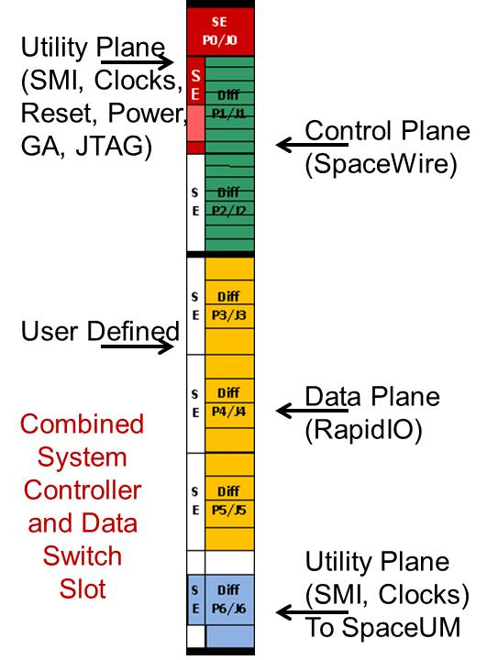
SpaceVPX 6U Slot Families
Payload Family:
Payload, Controller, Peripheral, Control Switch
Switch Family:
Data Switch, Switch & Controller, Control Switch
Or Ethernet
Or Ethernet
Or Ethernet
Or Ethernet
Pinouts are consistent throughout slot profile families enabling single design providing multiple slot types

Slide 45
SpaceVPX Slot Profile Keying (3U)
Key 1 | Key 2 | Module Type | Power Feeds (SpaceUM Only)
 |  |  | PF1 - PF4 | PF5 - PF7 | PF8 | Power Profile
0 | 0 | Power Supply Switch (3U Power) | -- | -- | --
270 | 45 | Switch (3U Power) | -- | -- | --
270 | 90 | Payload (3U Power) | -- | -- | --
270 | 0 | Utility Switch (3U Power) | -- | -- | --
45 | 90 | SpaceUM 5 Slot | +12V | PF5 = +3.3V PF6 = -12V PF7 = N/A | N/A | 5 Slot 12V
45 | 270 | SpaceUM 5 Slot | PF1-3 = +5V PF4 = +3.3V | PF5 = +12V PF6 = -12V PF7 = N/A | N/A | 5 Slot 5V
45 | 315 | SpaceUM 5 Slot | +3.3V | PF5=+12V PF6=-12V PF7 – N/A | N/A | 5 Slot 3.3V
90 | 0 | SpaceUM 2 Slot | 12 | 12 | -12 | 12V
90 | 45 | SpaceUM 2 Slot | 12 | 3.3 | -12 | 12V_3.3V
90 | 90 | SpaceUM 2 Slot | 12 | 5 | -12 | 12V_5V
90 | 270 | SpaceUM 2 Slot | 3.3 | 12 | -12 | 3.3V_12V
90 | 315 | SpaceUM 2 Slot | 3.3 | 3.3 | -12 | 3.3V
315 | 0 | SpaceUM 2 Slot | 3.3 | 5 | -12 | 3.3V_5V
315 | 45 | SpaceUM 2 Slot | 5 | 12 | -12 | 5V_12V
315 | 90 | SpaceUM 2 Slot | 5 | 3.3 | -12 | 5V_3.3V
315 | 270 | SpaceUM 2 Slot | 5 | 5 | -12 | 5V
315 | 315 | SpaceUM 2 Slot | Intermediate Power* | Intermediate Power* | Intermediate Power* | 0-18VDC
* See section 16.7.1.1.1.1 for the allocation of PF1-PF8 between positive and negative intermediate power inputs.

Slide 46
SpaceVPX Slot Profile Keying (6U)
Key 1 | Key 2 | Key 3 | Module Type | Power Feeds (SpaceUM and PSC Only)
 |  |  |  | Both: PF1-PF8, SpaceUM: PF17 | Both: PF9-PF16, SpaceUM: PF18 | SpaceUM: PF19 | SpaceUM: PF20 | Power Profile
270 | 270 | Open | Switch (3U Power) | -- | -- | -- | --
270 | 315 | Open | Payload (3U Power) | -- | -- | -- | --
315 | 270 | Open | Switch (6U Std Power) | -- | -- | -- | --
315 | 315 | Open | Payload (6U Std Power) | -- | -- | -- | --
90 | 0 | 0 | SpaceUM | 12 | 12 | 12 | -12 | 12V
90 | 0 | 45 | SpaceUM | 12 | 12 | 3.3 | -12 | 12V_3.3V
90 | 0 | 90 | SpaceUM | 12 | 12 | 5 | -12 | 12V_5V
90 | 0 | 270 | SpaceUM | 12 | 5 | 3.3 | -12 | 12V_5V_3.3V
90 | 45 | 0 | SpaceUM | 5 | 5 | 12 | -12 | 5V_12V
90 | 45 | 45 | SpaceUM | 5 | 5 | 3.3 | -12 | 5V_3.3V
90 | 45 | 90 | SpaceUM | 5 | 5 | 5 | -12 | 5V
90 | 45 | 270 | SpaceUM | 5 | 3.3 | 12 | -12 | 5V_3.3V_12V
90 | 90 | 0 | SpaceUM | 3.3 | 3.3 | 12 | -12 | 3.3V_12V
90 | 90 | 45 | SpaceUM | 3.3 | 3.3 | 3.3 | -12 | 3.3V
90 | 90 | 90 | SpaceUM | 3.3 | 3.3 | 5 | -12 | 3.3V_5V
90 | 90 | 270 | SpaceUM | 3.3 | 12 | 5 | -12 | 3.3V_12V_5V
90 | 270 | 0 | SpaceUM | 12 | 12 | 12 | 12 | 12V_max
90 | 270 | 45 | SpaceUM | 3.3 | 3.3 | 3.3 | 3.3 | 3.3V_max
90 | 270 | 90 | SpaceUM | 5 | 5 | 5 | 5 | 5V_max
90 | 270 | 270 | SpaceUM | NA | NA | NA | NA
90 | 315 | 270 | SpaceUM | Intermediate Power* | Intermediate Power* | Intermediate Power* | Intermediate Power* | 0-18VDC
90 | 315 | 315 | SpaceUM | Intermediate Power* | Intermediate Power* | Intermediate Power* | Intermediate Power* | 18VDC-36VDC
0 | 0 | 0 | PSC 18-36V Input | 12 | 12 | N/A | N/A | 12V
0 | 0 | 45 | PSC 18-36V Input | 12 | 12 | N/A | N/A | 12V_n3.3V
0 | 0 | 90 | PSC 18-36V Input | 12 | 12 | N/A | N/A | 12V_n5V
0 | 0 | 270 | PSC 18-36V Input | 12 | 5 | N/A | N/A | 12V_5V_n3.3V
0 | 45 | 0 | PSC 18-36V Input | 5 | 5 | N/A | N/A | 5V_n12V
0 | 45 | 45 | PSC 18-36V Input | 5 | 5 | N/A | N/A | 5V_n3.3V
0 | 45 | 90 | PSC 18-36V Input | 5 | 5 | N/A | N/A | 5V
0 | 45 | 270 | PSC 18-36V Input | 5 | 3.3 | N/A | N/A | 5V_3.3V_n12V
0 | 90 | 0 | PSC 18-36V Input | 3.3 | 3.3 | N/A | N/A | 3.3V_n12V
0 | 90 | 45 | PSC 18-36V Input | 3.3 | 3.3 | N/A | N/A | 3.3V
0 | 90 | 90 | PSC 18-36V Input | 3.3 | 3.3 | N/A | N/A | 3.3V_n5V
0 | 90 | 270 | PSC 18-36V Input | 3.3 | 12 | N/A | N/A | 3.3V_12V_n5V
0 | 270 | 0 | PSC 18-36V Input | 12 | 12 | N/A | N/A | 12V_MAX
0 | 270 | 45 | PSC 18-36V Input | 3.3 | 3.3 | N/A | N/A | 3.3V_MAX
0 | 270 | 90 | PSC 18-36V Input | 5 | 5 | N/A | N/A | 5V_MAX
0 | 270 | 270 | PSC 18-36V Input | NA | NA | NA | NA
0 | 315 | 270 | PSC 18-36V Input | Intermediate Power** | Intermediate Power** | N/A | N/A | 0-18VDC
0 | 315 | 315 | PSC 18-36V Input | Intermediate Power** | Intermediate Power** | N/A | N/A | 18VDC-36VDC
45 | -- | -- | Reserved
* See section 12.8.1.2.1.1 for the allocation of PF1-PF20 between positive and negative intermediate power inputs. ** See Section 10.7.1.1.2.1 for the PSC allocation of PF1-PF16 between positive and negative intermediate power inputs.

Slide 47
Existing VITA 78/VITA 78.1 Profiles

Slide 48
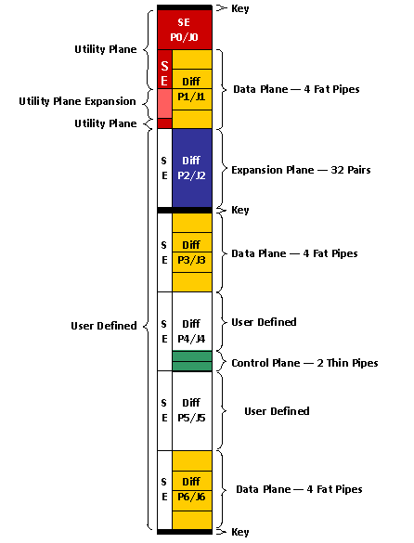
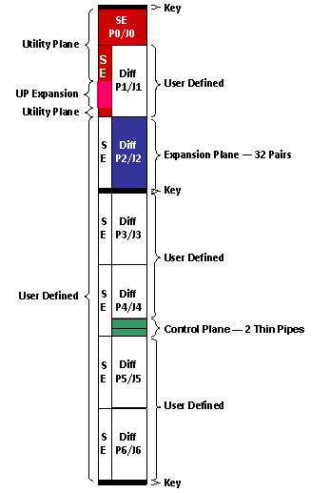
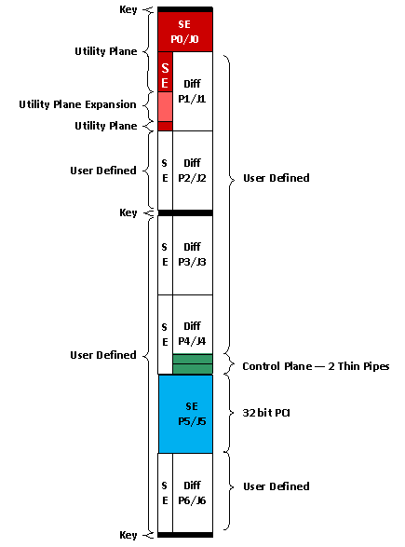
VITA 78 - 6U Slot Profiles
Payload
Payload
Peripheral
Peripheral

Slide 49
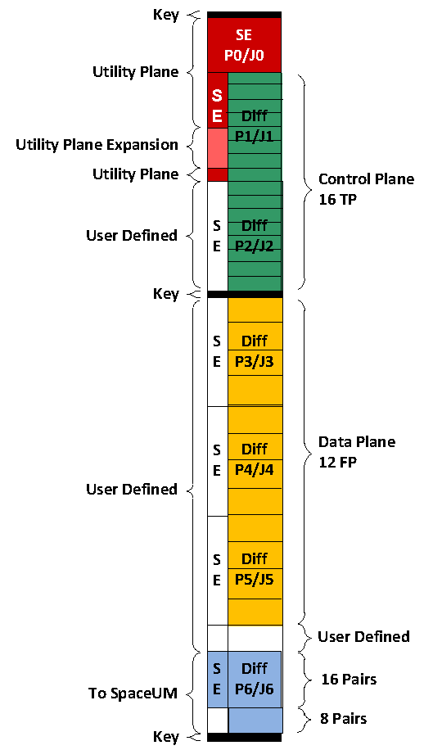

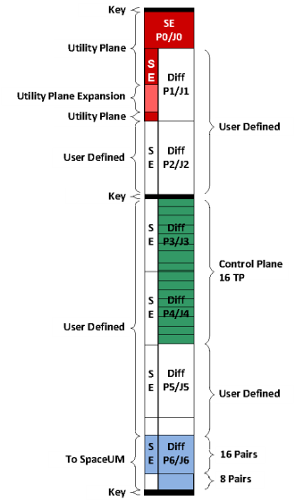
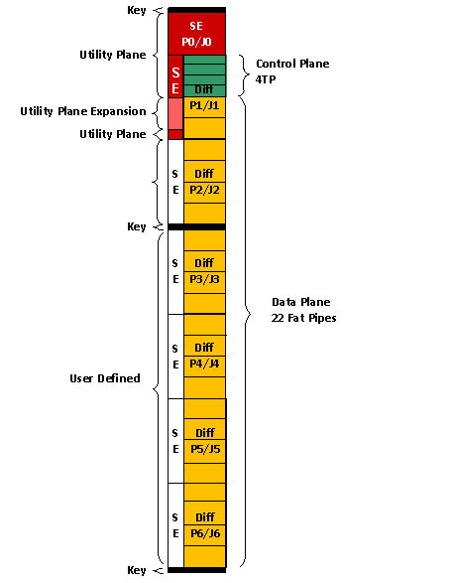
6U Slot Profiles
Switch and Controller
Data Switch
Data and Control Switch
Controller

Slide 50
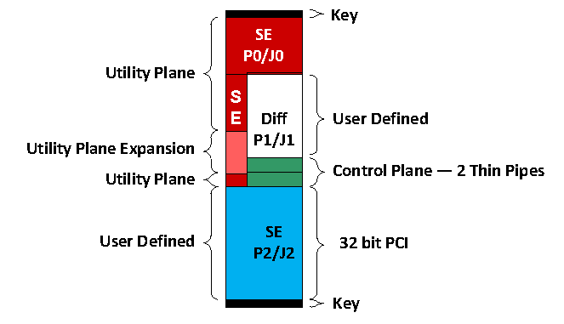
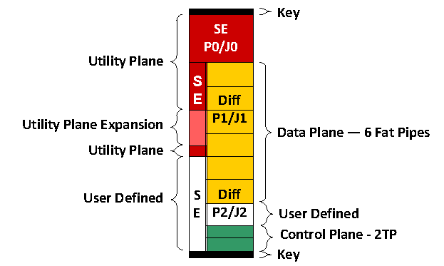
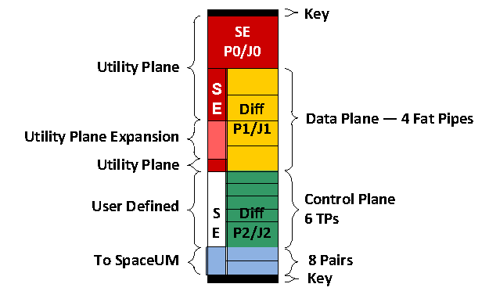
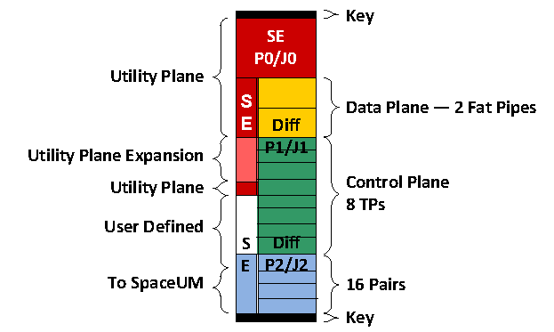
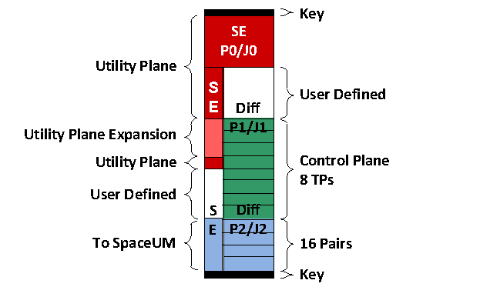
3U Slot Profiles
Payload
Payload
Peripheral
Switch or Mesh Slot
Switch and Controller
Controller
Controller

Slide 51
SpaceVPXLite Slot Profiles (Subset)
Note: This is not the complete set of profiles.

Slide 52
6U Connector Guidelines
All: J0 & J1 Row G: Utility Plane
Data Switch:
  J1AB: Up to 4 TP Control
  J2, J3, J4, J5, J6, J1CD: Up to 22 FP Data
Integrated Switches: Data, Management and Control:
  J1, J2: up to 16 TP Control
  J4, J3, J5, J2: up to 16 FP Data
  J6: up to 4 SpaceUM Utility Plane Feeds
Payloads:
  J1, J3, J6: Up to 12 Data FP
  J2: Expansion - Daisy Chained Up to 32 Pairs of Heritage or Data
  J4D: Control 2 TP
  J5: Expansion – Heritage (PCI 32 bit)
  J6, J5: Optical or RF
Controllers (Payload Compatible)
  J1: Up to 4 Data FP
  J2: Expansion - Daisy Chained Up to 32 Pairs of Heritage or Data
  J4, J3: Up to 16 TP Control
  J5: Expansion – Heritage (PCI 32 bit)
  J6: up to 4 SpaceUM Utility Plane Feeds
Non-assigned pins may be user defined

Slide 53

Payload Slot Profile (Switched)
Data-In Module
Possibility I
Data-Out Module
Data-In Module
Possibility II
Processing Module
Data-Out Module
Utilize User Defined Pins and Top of Card
Connectors for Additional Capability
Data-In Module
Possibility III
Processing Module
Storage Module
Any Combination of Payload Functions is Possible

Slide 54
Payload Slot Profile (Mesh)
Data-In Module
Possibility I
Data-Out Module
Data-In Module
Possibility II
Processing Module
Data-Out Module
Utilize User Defined Pins and Top of Card
Connectors for Additional Capability
Data-In Module
Possibility III
Processing Module
Storage Module
Any Combination of Payload Functions is Possible

Slide 55
SpaceVPX System Controller
Key element of SpaceVPX fault tolerance
Power channeled to System Controller which then directs powering of other modules
Uses System Management Interface (SMI) for chassis management then SpaceWire for Control Plane operations
SpaceWire router defined with System Controller may be separated with cross-strapping
Optional data plane connections
SpaceWire to other boxes
Power A and B
System
Controller
A
SpaceUM
A
SMI & Clocks
To 1-8 Modules
SpaceWire A
to all Modules
Router
SMI & Clocks
Power
Power & Sys Controller Selects
(fault tolerant)
SpaceWire
System
Controller
B
SpaceUM
B
SMI & Clocks
To 1-8 Modules
SpaceWire B
to all Modules
Router
SMI & Clocks
Power
Power A and B
SpaceWire to other boxes
SpaceWire may be used as C&DH or medium speed data path within SpaceVPX box
Optional data plane connections

Slide 56
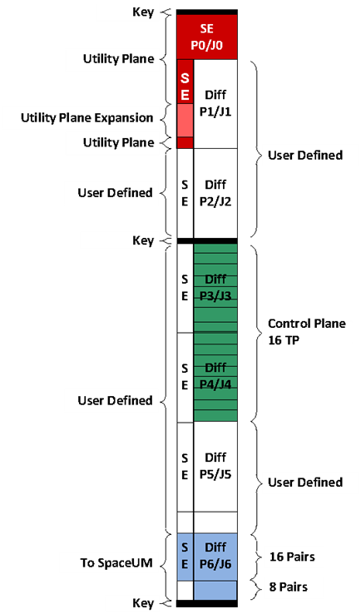
Controller Slot (without Data Plane Connection)
Processing Module
Possibility I
Controller Module
Control Switch Module
or
Utilize User Defined Pins and Top of Card
Connectors for Additional Capability
Storage Module
Controller Module
Possibility II
Control Switch Module
Processing Module
Any Combination of Payloads with Controller
or Control Switch is Possible

Slide 57
Data Switch and Controller Slot Profile
Controller Module
Possibility I
Data Switch Module
or
Control Switch Module
Possibility II
Data Switch Module
Utilize User Defined Pins and Top of Card
Connectors for Additional Capability
or
Controller Module
Possibility III
Control Switch Module
Data Switch Module
Any Combination of Data Switch with Controller
or Control Switch is Possible

Slide 58

Controller Slot (with Data Plane Connection)
Data-In Module
Possibility I
Control Switch Module
Controller Module
or
Utilize User Defined Pins and Top of Card
Connectors for Additional Capability
Data-In Module
Processing Module
Possibility II
Control Switch Module
Controller Module
Any Combination of Payloads with Controller
or Control Switch is Possible

Slide 59
Outline
What is SpaceVPX?
SpaceVPX Use Cases and Topologies
SpaceVPX Slot Profiles
SpaceVPX Backplane Profile
SpaceUM - Provisions for Redundancy and Fault Tolerance
SpaceVPX Mechanical General Specifications
SpaceVPX Compliance
Backup

Slide 60
I/O Planes in SpaceVPX
Expansion Plane
Data Plane
Control Plane
Utility Plane
Power Plane

Slide 61

Data Plane Switch Topology

Slide 62

Data Plane Mesh Topology

Slide 63

Control Plane Switch Topology

Slide 64


Example of 6U SpaceVPX Backplane Profile
Profile name | Mechanical |  | Slot Profiles and Section |  | Channel Gbaud Rate
 | Pitch (in) | RTM Conn | Payload | Switch & Controller | Control Plane | Data Plane | Exp. Plane
BKP6-CEN9- 11.2.5-1 | 1.2 | [VITA 46.10] | SLT6-PAY- 4F1Q2T- 10.2.1 | SLT6- SWC- 12F16T- 10.4.1 | 0.4 | 3.125 | 3.125
BKP6-CEN9- 11.2.5-2 | 1.2 | [VITA 46.10] | SLT6-PAY- 4F1Q2T- 10.2.1 | SLT6- SWC- 12F16T- 10.4.1 | 0.4 | 5.0 | 5.0
BKP6-CEN9- 11.2.5-3 | 1.2 | [VITA 46.10] | SLT6-PAY- 4F1Q2T- 10.2.1 | SLT6- SWC- 12F16T- 10.4.1 | 0.4 | 6.25 | 6.25

Slide 65
Outline
What is SpaceVPX?
SpaceVPX Use Cases and Topologies
SpaceVPX Slot Profiles
SpaceVPX Backplane Profile
SpaceUM - Provisions for Redundancy and Fault Tolerance
SpaceVPX Mechanical General Specifications
SpaceVPX Compliance
Backup

Slide 66
SpaceVPX Concept Development
Three concepts developed
  Concept 1 – Redefine an existing OpenVPX connector block as a second Utility/Management plane block (similar to P0/P1)
    Incompatible with existing OpenVPX modules
  Concept 2 – Extend the existing Open VPX connector by adding a second Utility/Management plane block (P7/P8 similar to P0/P1)
    Extends module height from 6U to 6U+TBD
    Partially compatible with existing OpenVPX modules
  Concept 3 – Add one or more Space Utility/Management (SpaceUM) modules with independent support for each OpenVPX module
    The SpaceUM module receives redundant Utility and Management Plane signals through the backplane and selects one set to be forwarded to the OpenVPX module Utility/Management plane signals
    Allows use of existing OpenVPX modules in appropriate flight applications

Slide 67
SpaceVPX Fault Tolerance
- Goal -
SpaceVPX is to achieve an acceptable level of fault tolerance, while maintaining reasonable compatibility with OpenVPX components, including connector pin assignments.
For the purposes of fault tolerance, a module is considered the minimum redundancy element.
The Utility Plane, Management Plane, and Control Plane are all distributed redundantly and in star topologies to provide fault tolerance.

Slide 68
SpaceVPX Fault Tolerance
For Space applications, the major fault tolerance requirements are listed below:
  Dual-redundant power distribution (bussed) where each distribution is supplied from an independent power source.
  Dual-redundant management distribution (point-to-point cross-strapped) where each distribution is supplied from an independent management controller to a SpaceUM module that selects between the A and B management controllers for distribution to each of the slots controlled by the SpaceUM module.
  Card-level serial management
  Card-level reset control
  Card-level power control
  Timing/synchronization/clocks, Matched length, low-skew differential
  Fault tolerant Utility Plane selection (bussed)
  Dual-redundant Data planes (point-to-point cross-strapped)
  Dual-Redundant Control planes (point-to-point cross-strapped)
  VITA 78 infrastructure allows for fully managed FRUs and for dumb FRUs (via VITA 46.11)

Slide 69
SpaceVPX Redundancy
Each of the interconnect planes defined by OpenVPX are supported by SpaceVPX as fully cross-strapped single-fault tolerant capable
  Control, Data and Expansion plane redundancy is provided using the existing OpenVPX connectivity
    Ability to utilize M-of-N payload module redundancy to support either higher reliability or degraded modes of operation
  The SpaceVPX Utility and Management plane redundancy is a major departure from OpenVPX
    OpenVPX uses single-source, bused power distribution
    OpenVPX uses single-source, bused clock, reset and management distribution
  Each interconnect plane can be implemented with reduced fault tolerance when desired

Slide 70
SpaceVPX Redundancy

Slide 71
SpaceVPX Utility Plane
The Utility Plane in a SpaceVPX backplane differs from the OpenVPX Utility Plane.
The OpenVPX Utility Plane includes bussed power distribution rails, bussed control/status signals, and bussed reference clocks.
The SpaceVPX Utility Plane includes redundant power distribution rails, redundant control/status signals and redundant reference clocks (with redundancy selected for each individual slot) distributed using a point-to-point tree topology.

Slide 72
SpaceVPX Utility Management
Architecture
  Provides single-fault-tolerance with limited increase in SWaP
    One SpaceUM module supports eight VPX slots
  Scalable to very large units
    Maximum of 31 VPX slots and 4 SpaceUM slots
  Dual-redundant power distribution
    Allows traditional space methods
  Dual-redundant management distribution
    Traditional capability using improved methods
  Accommodates supplier-preferred methods for implementing interoperable products
Topology
  Traditional tree-topology is familiar to space suppliers
  Flexible command/status interface options allow tailoring to customer needs

Slide 73
SpaceVPX Utility Management
Comparison with OpenVPX
OpenVPX restricts the maximum number of slots to the number of 0.8-inch slots in a 19-inch development chassis.
Because SpaceVPX does not require the use of 19-inch development chassis, the slot restrictions of OpenVPX are relaxed.
Language
The backplane shall have no greater than 31 managed slots. [VM = I]
A backplane with 31 slots may have 31 Plug-In Modules and 31 RTMs installed.
The SpaceVPX system designer must address any compatibility issues in the number of slots if using OpenVPX modules.

Slide 74
SpaceVPX System (Chassis) Management
Leverages the VITA 46.11 industry standard
  Limited subset to minimize complexity
Defines an alternative light-weight protocol for less complex systems
Basic functions supported
  Individual module power on-off control
  Individual module reset control
  Individual module status monitoring
Advanced capabilities
  Module-level telemetry acquisition
    Voltage, temperature, digital state, etc.
  Module-level functional control
    Sub-function power control, register access, memory access, etc.

Slide 75

Location of Chassis Manager
All the Backplane Profiles in VITA 78 (SpaceVPX) show the location for the ChMC.
  The ChMC is typically with a Switch Slot, if there is one.
  For topologies other than the Switched, one of the other VITA 78 Slots is specified.
  The Chassis Manager (including ChMC) may be where it is indicated on the topology diagram or somewhere else in the chassis
The ChMC does not have to reside on a VITA 78 Slot Profile. It is possible for it to be located elsewhere.

Slide 76

VITA 46.11 – Chassis Management and IPMCs Tiers of Functionality
IPMC Tiers
Minimum capabilities of a Tier-1 IPMC:
  Be responsible for System IPMB start-up and fault handling.
  Support the discovery of the FRU it controls.
  Support access to the management information for the FRU it controls.
Min capabilities of a Tier-2 IPMC, in addition to Tier-1:
  Participate in event generation and reception.
  Support Dynamic Sensor Devices.
  Optionally support Subsidiary FRUs.
Min capabilities of a Tier-3 IPMC, in addition to Tier-2:
  Support redundant System IPMB interfaces
  Support operating the System IPMB in FAST-MODE (400 kHz)
  Provide local event logging for locally generated events
  Support FRU activation, resets, and control bits
  Support IPMI message bridging for Intelligent Subsidiary FRUs
  Provide IPMI message firewall capability

Slide 77
SpaceVPX IPMI Commands
Command Name | [IPMI 1.5] / [VITA 46.11] Section | ChMC | IPMC | Notes
Get Device ID | IPMI 17.1 | Mand. | Mand. | Reads basic module data as specified by IPMI format. Vendor must document response in IPMI format.
Get Self-Test Results | IPMI 17.4 | Mand. | Mand. | Reads self-test result, if any. Response is defined by vendor documentation. Self-test result can be part of Payload Test and/or Module Status Health Sensor (Sensor #2) data. Vendor must document response in IPMI format.
Get Sensor Reading | IPMI 29.14 | Mand. | Mand. | Reads status and command registers as specified by vendor. Vendor documentation provides details of each sensor, including sensor response.
Get System Management Reset Command | 5.2.1.4.1 | Mand. | Mand. (Sys. Man) | Monitors the state of the SM_RESET* signal of each module in a System Management domain. Mandatory for System Management infrastructure modules, otherwise, not implemented.
Set System Management Reset Command | 5.2.1.4.1 | Mand. | Mand. (Sys. Man) | Controls the state of the SM_RESET* signal of each module in a System Management domain. Mandatory for System Management infrastructure modules, otherwise, not implemented.
Get System Management Health Status Signals Command | 5.2.1.4.2 | Mand. | Mand. (Sys. Man) | Monitors the state of the SM_STAT* signal of each module in a System Management domain. Mandatory for System Management infrastructure modules, otherwise, not implemented.
Get Module Primary Power Enable Command | 5.2.1.4.3 | Mand. | Mand. (Sys. Man) | Monitors the state of the Primary Power Enable signal of each module in a System Management domain. Mandatory for System Management infrastructure modules, otherwise, not implemented.
Set Module Primary Power Enable Command | 5.2.1.4.3 | Mand. | Mand. (Sys. Man) | Controls the state of the Primary Power Enable signal of each module in a System Management domain. Mandatory for System Management infrastructure modules, otherwise, not implemented.
Get Module System Reset Signals Command | 5.2.1.4.4 | Mand. | Mand. (Sys. Man) | Monitors the state of the System Reset (SYSRESET*) signal of each module in a System Management domain. Mandatory for System Management infrastructure modules, otherwise, not implemented.
Set Module System Reset Signals Command | 5.2.1.4.4 | Mand. | Mand. (Sys. Man) | Controls the state of the System Reset (SYSRESET*) signal of each module in a System Management domain. Mandatory for System Management infrastructure modules, otherwise, not implemented.
Get System Management Discrete Output Signals | 5.2.1.5.1 | Mand. | Opt. | Monitors the state of the System Management Discrete Output signals of each module in a System Management domain. Optional for IPMCs.
Set System Management Discrete Output Signals | 5.2.1.5.1 | Mand. | Opt. | Controls the state of the System Management Discrete Output signals of each module in a System Management domain. Optional for IPMCs.
Get System Management Discrete Input Signals | 5.2.1.5.2 | Mand. | Opt. | Monitors the state of the System Management Discrete Input signals of each module in a System Management domain. Optional for IPMCs.
Notes: The values in this table are from [VITA 46.11] Table 10.1.1-1, with the last ten adapted for SpaceVPX.

Slide 78
DAP - Mandatory System Management Controls
System Management Controls | Description
System Management Reset Control | Controls and monitors the state of the System Management Reset (SM_RESET*) signals for all modules within the System Management domain.
System Management Health Status | Monitors the state of the System Management Health Status (SM_STAT*) signals for all modules within the System Management domain.
Module Primary Power Enable Control | Controls and monitors the state of the Module Primary Power Enable signals for all modules within the System Management domain.
Module System Reset Control | Controls and monitors the state of the Module System Reset (SYSRESET*) signals for all modules within System Management domain.
The System Management infrastructure is responsible for the distribution of the System Management IPMB and discrete signals, as well as primary power and reset, to the SpaceVPX Modules.
Four sets of controls are defined specifically for the management of these signals and functions.

Slide 79
DAP - Optional System Management Discrete Signals
System Management Discrete Signals | Description
System Management Discrete Output Signals | Controls and monitors the state of a set of 32 discrete output signals.
System Management Discrete Input Signals | Monitors the state of up to 32 discrete input signals.
A SpaceVPX Module can optionally provide commanded discrete outputs and inputs.
Two optional sets of discrete signals, each containing 32 bits, are defined specifically to control and monitor the state of discrete signals on a module.
The IPMC on a module can support one or more discrete outputs or inputs.
The use of these discrete signals is implementation-specific.

Slide 80
Direct Access Protocol
Direct Access Protocols
Are alternatives to the IPMI protocol, which map the configuration, control, and status functions into a set of memory-mapped registers.
A common set of memory-mapped registers are defined common to all Direct Access Protocols, with the function and address of each register being defined.
A Direct Access Protocol
Is a protocol that uses this memory mapping to access the configuration, control, and status registers.
Process
A Chassis Management Controller (ChMC) in a system controller talks to an Intelligent Platform Management Controller (IPMC) in each of one or more modules not operating as the system controller.
The ChMC sends a register write or read request and the IPMC fulfills that request, writing the data to the addressed register and sending an acknowledgement back to the ChMC, or reading the data from the addressed register and sending it back to the ChMC.

Slide 81
Direct Access Protocol
There are two Direct Access Protocols,
  SpaceVPX Direct Access Protocol
  RMAP.
The SpaceVPX Direct Access Protocol
Uses a custom designed protocol to read and write registers over an I2C bus.
The ChMC Direct Access Protocol is defined in Section 5.2.2.5 and the corresponding IPMC protocol is defined in Section 5.2.2.6.
The Remote Memory Access Protocol (RMAP)
Is a standard protocol for SpaceWire and SpaceFibre.
If SpaceWire or SpaceFibre are being used for the control plane, the RMAP protocol can be used to access management functions over the control plane using the memory map of the Direct Access Protocol.
The use of the RMAP protocol for ChMC is defined in Section 5.2.2.7 and for IPMC in Section 5.2.2.8.

Slide 82

System Controller/Utility Plane

Slide 83
Space Utility-Management (SpaceUM) Module Architecture
The SpaceVPX SpaceUM module provides selection functions for the dual-redundant Utility Plane (power) distribution and for the dual-redundant Utility Plane system control distribution.
By combining the Power Selection and Management Selection functions in the SpaceUM module, SpaceVPX provides compatibility with existing OpenVPX capabilities and implementations.
Note that although the SpaceUM module is an integral part of the SpaceVPX power distribution system, it is not a power supply and does not include transformer-coupled power isolation capability.
Note: Implementers that choose to provide power isolation in the SpaceUM module are exceeding the scope of this specification.

Slide 84
SpaceVPX Management Distribution Topology
VPX Slot (IPMC)
Select Circuit
Management Fanout A (IPMC)
Select Circuit
VPX Slot (IPMC)
System Controller A VPX Slot
(ChMC)
Select Circuit
Select Circuit
VPX Slot (IPMC)
SYS_RST
System
Management
Select Circuit
VPX Slot (IPMC)
Controller Select
Select (discrete)
Management Select
System Controller B VPX Slot
(ChMC)
Select Circuit
Management Fanout B (IPMC)
Select Circuit
VPX Slot (IPMC)
SYS_RST
System
Management
VPX Slot (IPMC)
Select Circuit
Select Circuit
VPX Slot (IPMC)

Slide 85
SpaceVPX Management Distribution Topology

Slide 86

SpaceVPX IPMB Topology

Slide 87

Power/Utility Plane

Slide 88
SpaceVPX Power Distribution Topology
VPX Slot
Select Circuit
Select Circuit
VPX Slot
System Controller A VPX Slot
(ChMC)
Select Circuit
Select Circuit
VPX Slot
Power A
Power Supply
Select Circuit
VPX Slot
Power Select
Select (discrete)
Utility Select
Power Supply
Power B
System Controller B VPX Slot
(ChMC)
Select Circuit
Select Circuit
VPX Slot
VPX Slot
Select Circuit
Select Circuit
VPX Slot

Slide 89
Power Supply-Switch Module Profiles
The SpaceVPX Power Supply-Switch module includes transformer-coupled power isolation capability between the Front Panel main power input and the secondary power outputs.
The secondary output power switching capability supports dual-redundant SpaceVPX Utility Plane power distribution and allows the individual VPX slot power management needed for SpaceVPX redundancy management.
By incorporating these functions, the Power Supply-Switch module provides compatibility with existing OpenVPX capabilities and implementations.
SpaceVPX Power Supply-Switch modules are intended for use in redundant configurations where one module of the redundant set is active, and all others are inactive.
The fault-tolerant POWER_SEL[5..0] signals are used to inform each Power Supply-Switch module of its current state (active or inactive).
System integrators are responsible for distributing the Power Select signals to the Power Supply-Switch modules in a manner that provides the desired redundancy control and fault tolerance.

Slide 90
Outline
What is SpaceVPX?
SpaceVPX Use Cases and Topologies
SpaceVPX Slot Profiles
SpaceVPX Backplane Profile
SpaceUM - Provisions for Redundancy and Fault Tolerance
SpaceVPX Mechanical General Specifications
SpaceVPX Compliance
Backup

Slide 91
Mechanical - Overall
General Form Factor – VITA 46
Conduction Cooled Modules – VITA 48.2
  Updated figures
  Screw and tab modules with addition of threaded holes
  Separate extraction tool for non-levered modules
Pitch – 0.8”, 1.0”, 1.2”, 1.4”, and 1.6” (default)
  Multiple pitch cards may be used
160 mm standard length
  220, 280 and 340 mm allowed
Accommodates larger wedgelock
Connections to PWB ground allowed
Connector – VITA 46.0 (TE and Amphenol), VITA 60 (Amphenol) or VITA 63 (Smiths) may be used
Strongly leverages existing OpenVPX mechanical infrastructure and standards

Slide 92




VPX Backplane Connector Options
TE Connectivity RT 2 shown
Plug-In Module
Even differential wafer
Odd differential wafer
Backplane
[VITA 46.0] connectors
  TE Connectivity RT 2 – original [VITA 46.0] connector, deployed in many applications
  TE Connectivity RT 2-R – [VITA 46.0] connector developed to be more rugged
    Inter-mates with RT 2 and the PCB (Printed Circuit Board) footprints are the same for both – connectors are footprint compatible
  Amphenol R-VPX – inter-mates and PCB footprint compatible with RT 2 and RT 2-R
    Rugged like RT 2-R with 4 points of contact
  Higher bandwidth connectors being standardized by [VITA 46.30] and [VITA 46.31]
  Intended to go to at least 25 Gbaud signaling for protocols such as 100GBASE-KR4 and PCIe Gen 4
  Inter-mate with RT 2, RT 2-R, and R-VPX; but the PCB footprints are different from RT 2, RT 2-R, and R-VPX
  TE Connectivity RT 3 and Amphenol R-VPX EVO 2 are designed to be compliant to [VITA 46.30]
    RT 3 and RVPX EVO 2 have same PCB footprints and inter-mate with each other as well as other [VITA 46.0] connectors
    Rugged like RT 2-R
Amphenol Viper [VITA 60.0] and Smiths KVPX [VITA 63.0]
  Do not inter-mate with each other or with [VITA 46.0] connectors
  Footprint compatible with RT 2-R and R-VPX – same PCB can be used with any of these connectors
Pictures above & left courtesy of TE Connectivity
R-VPX Plug-In Module (above) and backplane (below) connectors, courtesy of Amphenol Aerospace
Slide Courtesy of Greg Rocco – MIT-LL

Slide 93

Connector Configurations specific for SpaceVPX
VITA 78 leverages VITA 46.0 VPX, but VITA 78 includes several connector configurations (power/single-ended/diff pair mix) specific for Space VPX. These are used in SpaceUM modules, Power Supply Switches and Power Supply / Controllers and provide redundant power.
Connector designations Module 8, Module 16A, 16B, … are used for these connectors and the pin (wafer) layouts are defined in tables in VITA 78 (example shown).
Current capacity testing has been completed on VITA 46 connectors to validate the current ratings of adjacent power wafers on the following slide.

Slide 94

SpaceVPX Connector Pad and Wafers Current Ratings

Slide 95
Connector Testing for Space Applications
Connector manufacturers have done extensive testing to validate use in space and should be consulted on specific environmental or mechanical requirements.
For example, tests for VITA 46.0 connectors have included outgassing, pyro-shock, and extended temperature cycling from -65C to 125C.
In most cases COTS OpenVPX connectors will support space environments. But there may be a need to add additional inspection/screening and/or environmental testing specific to the mission requirements.
Connectors are also offered with heavier lead content in the contact tail plating (60/40 tin-lead vs standard COTS 93/7) to further mitigate the risk of tin whiskers.

Slide 96


6U/3U SpaceUM Connector
The SLT3-SUM-2S3V3A1B1R1M4C SpaceUM Slot Profile contains two switched power outputs that supply Vs1, Vs2, Vs3, 3.3V_AUX, 12V_AUX, -12V_AUX and VBAT to each VPX slot.
The slot profile also contains two switched control signal interfaces that direct control signals to each VPX slot.

Slide 97

3U SpaceUM - continued
The SLT3-SUM-5S3V3A1R1M3C SpaceUM Slot Profile contains five switched power outputs that supply.
One primary power voltage (+12V, +5V or +3.3V as determined by slot keying), 3.3V_AUX, 12V_AUX and -12V_AUX to each VPX slot.
The slot profile also contains five switched control signal interfaces that direct control signals to each VPX slot.

Slide 98
SpaceUM SLT3-SUM-5S1V3A1R1M3C-14.7.2 – P2
SpaceUM SLT3-SUM-5S1V3A1R1M3C-14.7.2 – P1
SpaceUM SLT3-SUM-5S1V3A1R1M3C-14.7.2 – P0

Slide 99

Power Supply Switch Slot Profile
The SLT3-PSS-6S3V3A1B Power Supply-Switch Slot Profile contains six switched power outputs that supply Vs1, Vs2, Vs3, 3.3V_AUX, 12V_AUX, -12V_AUX and VBAT to each slot.
The slot profile also contains one unswitched power output that supplies Vs1, Vs2, Vs3, 3.3V_AUX, 12V_AUX and -12V_AUX to power Utility Switch slots.

Slide 100

Utility Switch Slot Profile
The SLT3-SUS-10S4M2C1R Utility Switch Slot Profile contains ten switched control outputs that are distributed to each payload slot.

Slide 101


6U and 3U Form Factor Plug-In Unit Dimensions
OpenVPX
SpaceVPX

Slide 102


Blind-Mate Optical and Coax Connectors
Specific SpaceVPX slot profiles include apertures to be populated with optical and/or coax modules. This enables optical and coax connections to mate when Plug-In Module is plugged in, eliminating front panel connections.
Aperture H defines a backplane cutout which allows an optical/coax connector module to replace a full size backplane connector, for example in P2/J2.
Aperture J defines a backplane cutout which replaces a half size (8-wafer) backplane connector, for example in P2B/J2B.
Coax connector module interfaces are defined in VITA 67.3 with three contact interface options (SMPM, SMPS, NanoRF)
Optical and Hybrid (Optical/Coax) connector module interfaces are defined in VITA 66.5 and use MT ferrules.
Standard connector module layouts that fit these apertures are defined in VITA 65.1 and offer options for populating coax contacts and optics for the plug-in module to backplane connection.

Slide 103



VITA 66.5 Optical Module Features
Plug-In Module side
Cabled MT
Same mating interface
Edge Mount Transceiver
Backplane side
Plug-In Module PCB
Style C – Hybrid
Style D
VITA 66.5 Optical Connector Modules designed to enable MT float only on the backplane, enabling both:
  Cabling to a mid-board transceiver
  Transceivers at the edge of the Plug-In Module
VITA 66.5 Style D has highest optical density with 3 MT’s in a half size connector module.
VITA 66.5 Styles A and B are legacy and not recommended for new designs.
Images courtesy of TE Connectivity

Slide 104





VITA 67.3 Coax Contact Interfaces
Image courtesy of Mercury Systems
SMPM
  The coax contact interfaces for the initial release of VITA 67.3
  Supports frequencies to 40 GHz
  Up to 14 SMPM contacts in a full size module
SMPS
  Enables higher density than SMPM
  Supports frequency to 70 GHz
  Up to 19 SMPS contacts in a full size module
NanoRF
  Enables higher density than SMPM
  Supports frequency to 70 GHz
  Up to 9 NanoRF contacts in a half‑size module
  Used in VITA 66.5 Style C-Hybrid optical/RF Connector Modules
Backplane contacts are spring- mounted to assure the interface stays fully bottomed for best performance under harsh environments
SMPM and NanoRF images courtesy of TE Connectivity; SMPS image courtesy of SV Microwave

Slide 105

VITA Standards Defining Mechanical Interface of Optical/Coax Connector Modules
VITA 67.3
VITA 66.5
Secondary guide features for
Optical and Hybrid Connector Modules
RF contact interface
RF Connector Module guide feature
MT ferrule interface
Primary guide features (tab/slot) for Optical and Hybrid Connector Modules
Backplane Aperture –
dimensions and location within a slot
VITA 65.1
Backplane Connector Module
dimensions (RF, optical and hybrid)
X-Y locations for RF contacts, MT ferrules, and guide features within a backplane Connector Module
65.0/65.1 Partitioning, Connector Module Standards: first, 2nd

Slide 106
Proposed Slot Profile Name Construction
SLTU y – PAY- nXnXnX-1X.x.x-n
n = a line in the Slot Profile spreadsheet identifying specific connector aperture pattern (if any) and RF or optical module population (if any)
Board Size
U = 3 or 6
VITA 65 Sections 10 or 14
n = # pipes
or connector patterns
y = Clock variations
p = parallel termination
s = series termination
x = radial - not defined
Omitted field = bussed
X = Type of Pipes or Aperture
Pipes (number of diff. pairs or discrete fibers)
S= Single Pipe (1)
U= Ultra-thin (2)
T= Thin (4)
F= Fat (8)
M= Ten (10)
W=Twelve (12)
D= Double (16)
Q= Quad (32)
O= Octal (64)
Connector aperture name (Connector Module size)
A= 66.1 (full)
B= 66.2 (full)
C= 66.3 (full)
E= 66.4/ 67.1/ 67.3A (half)
G= 67.2/ 67.3B (full)
H= 67.3C (full new)
J= 67.3D (half new)
K= 67.3E (full+half new)
Slot type
PAY = payload
STO = storage
PER = peripheral
SWH = switch
TIM = timing
Note: That order of Pipes is from top to bottom in the physical slot

Slide 107
Outline
What is SpaceVPX?
SpaceVPX Use Cases and Topologies
SpaceVPX Slot Profiles
SpaceVPX Backplane Profile
SpaceUM - Provisions for Redundancy and Fault Tolerance
SpaceVPX Mechanical General Specifications
SpaceVPX Compliance
Backup

Slide 108
SpaceVPX Compliance
SpaceVPX standards enable the creation of robust high performance space electronics systems. SpaceVPX standardizes the interfaces necessary for developing and integrating interoperable standard electronics modules leveraging the [VITA 65] family of standards. There are many levels of user definition while maintaining the base capabilities needed for such systems. SpaceVPX provides for the following levels of compliance and compatibility.
A SpaceVPX compliant module meets the module requirements of Section 8 and Section 12 (6U) or Section 16 (3U).
A SpaceVPX compliant development chassis meets the development chassis requirements of Section 9 and Section 13 (6U) or Section 17 (3U).
A SpaceVPX compliant backplane meets the backplane requirements of Section 7 and Section 11 (6U) or Section 15 (3U).
Permission 2-1: Compliant backplane implementations based on an included topology may be reduced by any number of slot types and/or increased by any number of peripheral slots, as long as single-fault tolerance requirements are maintained.

Slide 109
SpaceVPX Compliance (2)
A SpaceVPX compatible backplane meets the backplane requirements of a SpaceVPX compliant backplane while allowing the absence of spares (redundant modules) and/or SpaceUM modules.
A SpaceVPX compatible module is any module that operates without causing damage to itself or other SpaceVPX elements when plugged into a SpaceVPX slot as defined in Section 6 and Section 10 (6U) or Section 14 (3U) contained within a SpaceVPX backplane as defined in Section 7 and Section 11 (6U) or Section 15 (3U). Any OpenVPX module not modified to be compliant with the SpaceVPX standard is SpaceVPX compatible if it meets the requirements for a SpaceVPX compatible module.
A fully compliant fault tolerant SpaceVPX system provides at least single fault tolerant capabilities throughout.
Permission 2 2: Based on the system reliability requirements, modules may be combined or attached.
Rule 2-2: Single point fault tolerance shall be achieved between each redundancy grouping as well as on all intergroup interfaces.
Such a system typically includes a SpaceVPX compliant chassis, a SpaceVPX compliant backplane, one to four SpaceUM modules and two or more SpaceVPX compliant and/or compatible modules.

Slide 110
Questions?

